Slide 1
STANDARD:
SS6G1 The student will locate selected features of Latin America and the Caribbean.
© Brain Wrinkles

Slide 2
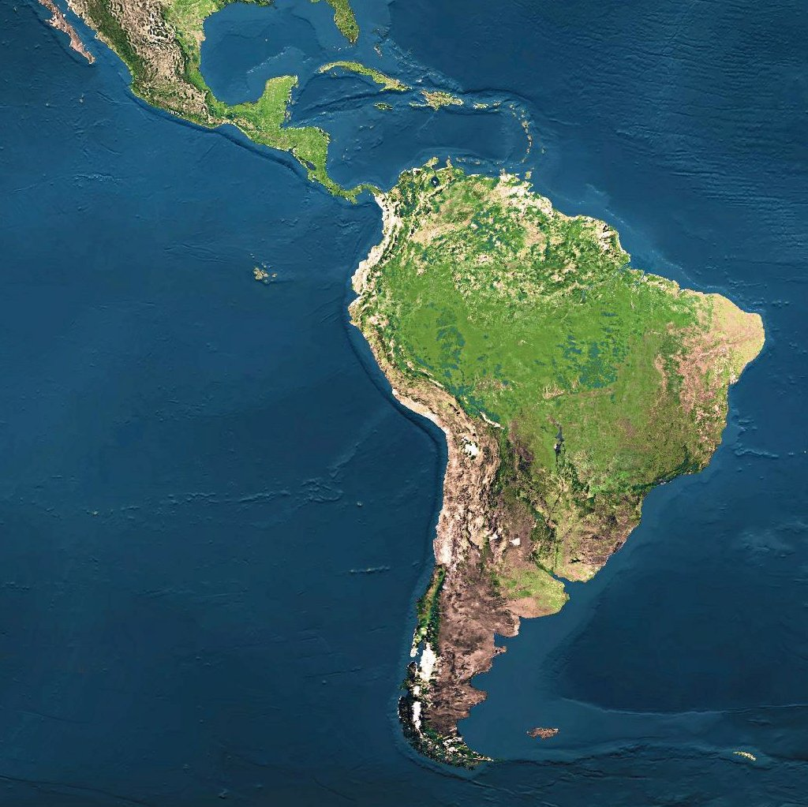
Geography of
Latin America
© Brain Wrinkles

Slide 3
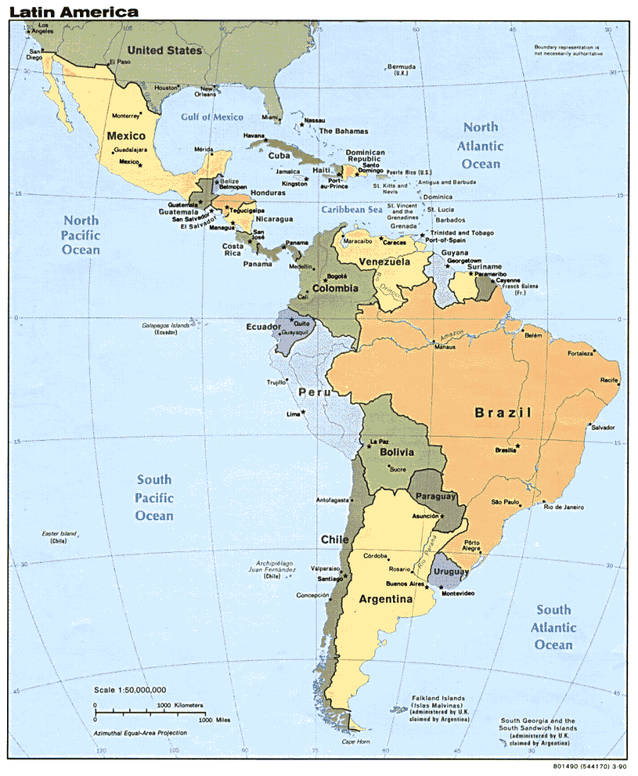
Geography
Latin America is divided into three regions:
Mexico and Central America
The Caribbean
3. South America
© Brain Wrinkles

Slide 4
Mexico &
Central America
2,500 miles (about as wide as the US)
Mountains dominate the region
Part of a huge system that extends from Canada, through the US, and all the way to the tip of South America
Central plateau in Mexico
Lies between Sierra Madre mountains and makes up more than half of the country’s area
Central America is an Isthmus
Isthmus = a narrow strip of land that has water on both sides and joins 2 larger bodies of water
Many volcanoes in Central America, as a result, their soil is arable (fertile) and many people farm lands
© Brain Wrinkles

Slide 5
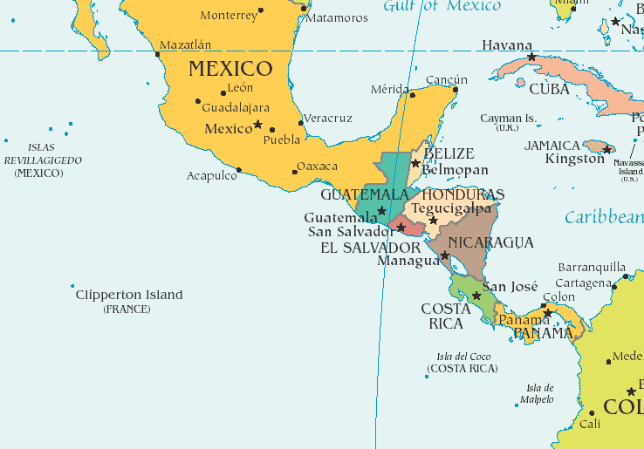
© Brain Wrinkles

Slide 6
Amazon River
A river, located primarily in Brazil, that is nearly 4,000 miles long.
It’s the 2nd largest river in the world (1st is the Nile River).
The river contains 20% of all fresh water in the world!
It serves as a natural highway where it’s hard to build roads.
It provides food and hydroelectric power.
© Brain Wrinkles

Slide 7
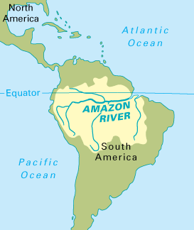
© Brain Wrinkles

Slide 8
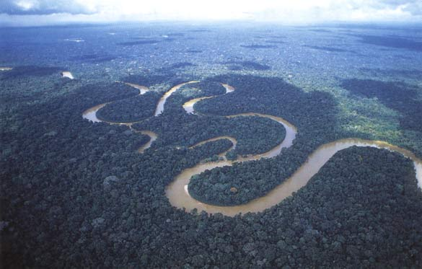
© Brain Wrinkles

Slide 9
Amazon Rainforest
The Amazon Rainforest is a large tropical rainforest occupying the drainage basin of the Amazon River.
It covers much of northwestern Brazil and extends into Colombia, Peru, and other South American countries. It is the world’s largest tropical rainforest.
© Brain Wrinkles

Slide 10
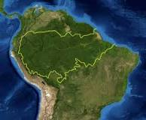
© Brain Wrinkles

Slide 11
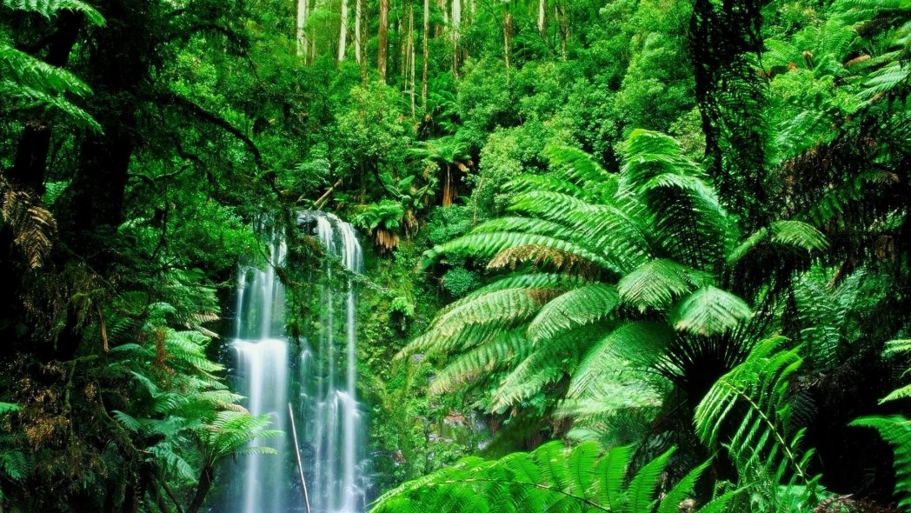
© Brain Wrinkles

Slide 12
Caribbean Sea
A sea in the Atlantic Ocean surrounded by Mexico, Central America, and small Caribbean countries.
It’s a major trade route for Latin American countries.
A popular tourist area—noted for its mild tropical climate and beautiful waters
© Brain Wrinkles

Slide 13
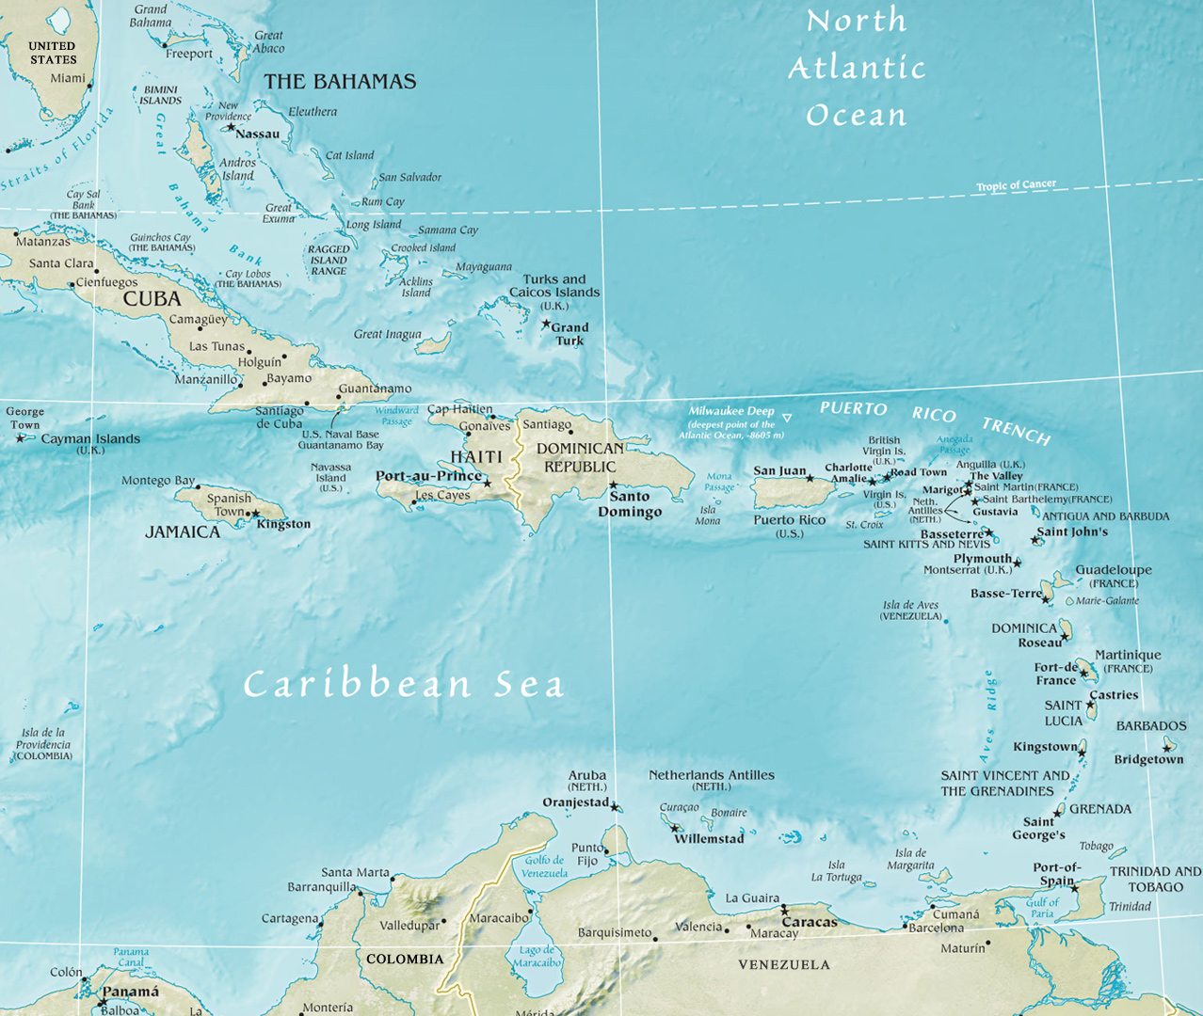
© Brain Wrinkles

Slide 14
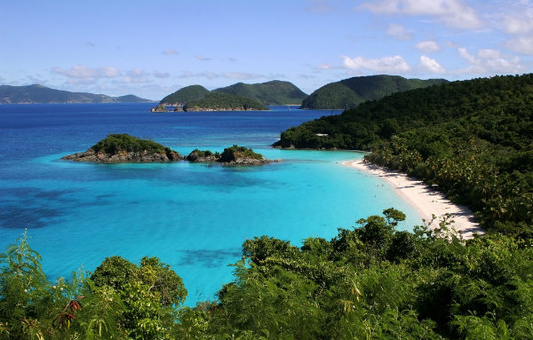
© Brain Wrinkles

Slide 15
Gulf of Mexico
The Gulf of Mexico is a body of water that is part of the Atlantic Ocean and is surrounded by Mexico, the southern U.S., and Cuba.
© Brain Wrinkles

Slide 16
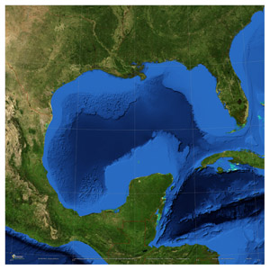
© Brain Wrinkles

Slide 17
Atlantic Ocean
The second largest ocean in the world. It covers approximately 20% of the Earth’s surface.
© Brain Wrinkles

Slide 18
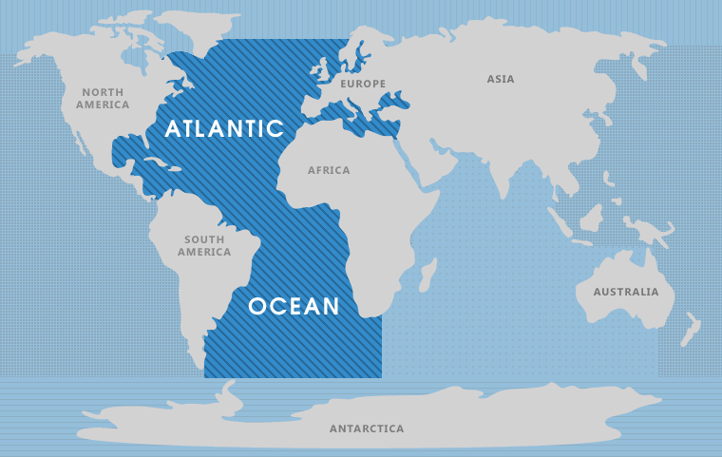
© Brain Wrinkles

Slide 19
Pacific Ocean
World’s largest and deepest ocean.
Covers the western coast of South America
It is the location of the deepest trench in the world, the Mariana Trench.
© Brain Wrinkles

Slide 20
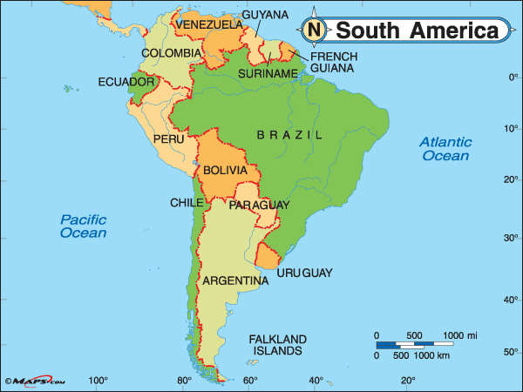
© Brain Wrinkles

Slide 21
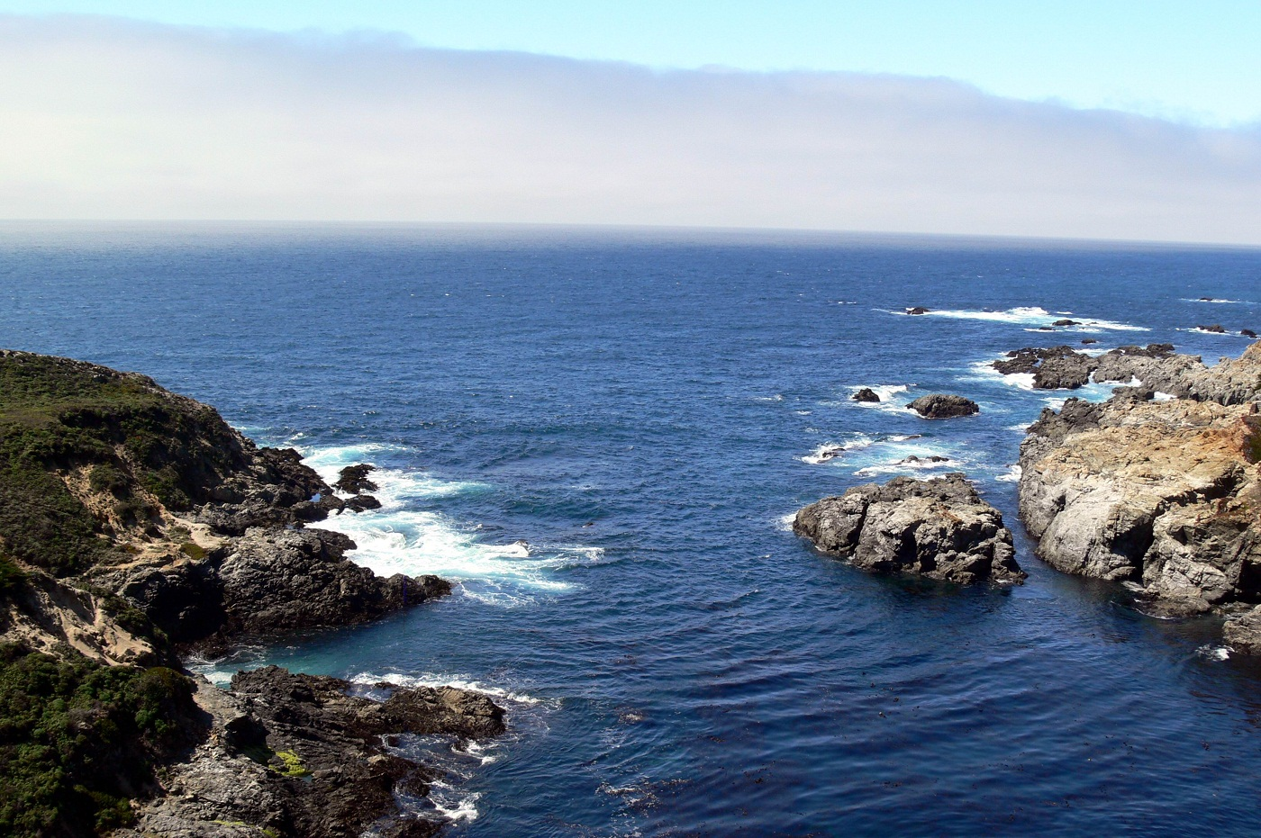
© Brain Wrinkles

Slide 22
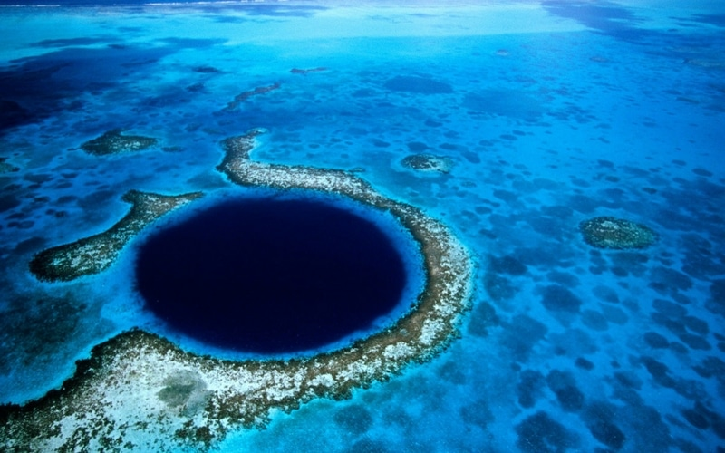
Mariana Trench: Off the coast of the Philippines.
© Brain Wrinkles

Slide 23
Panama Canal
A 51 mile long, man-made canal. It is a major “shortcut” that allows ships to travel between the Pacific and Atlantic oceans.
It handles a large volume of world shipping and enables ships to avoid traveling around South America, reducing their voyages by thousands of miles and many days.
It consists of artificially created lakes, channels, and a series of locks, or water-filled chambers, that raise and lower ships through the mountainous terrain of central Panama.
© Brain Wrinkles

Slide 24
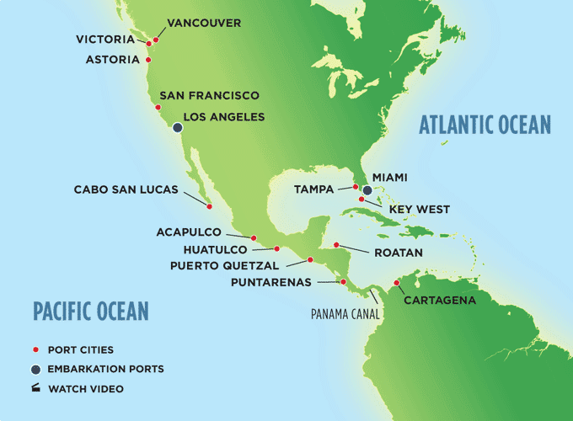
© Brain Wrinkles

Slide 25
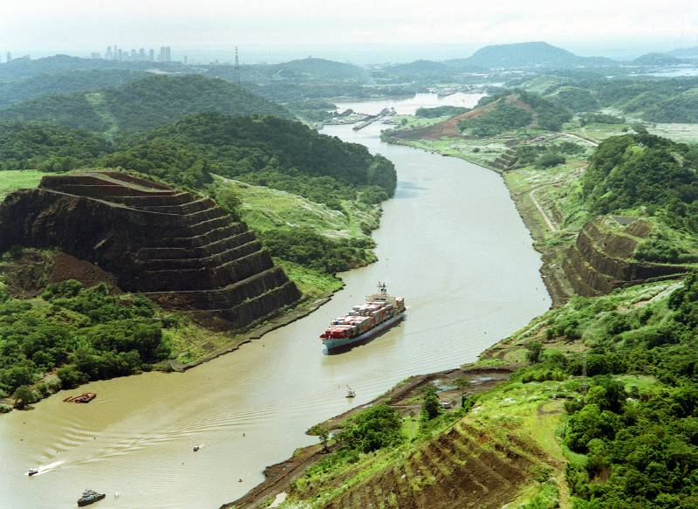
© Brain Wrinkles

Slide 26
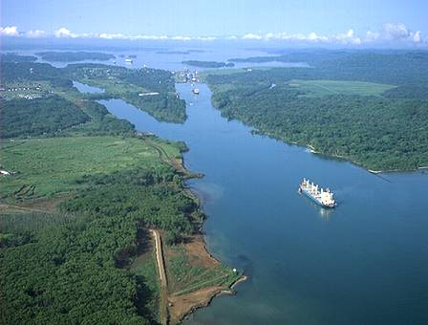
© Brain Wrinkles

Slide 27
Andes Mountains
4,500 mile long mountain system that is the source of most major rivers in South America.
They rise at some points to 20,000 feet—same height as twenty 100 story buildings stacked on top of each other!
2nd largest mountains in the world--Himalayas are the 1st.
© Brain Wrinkles

Slide 28
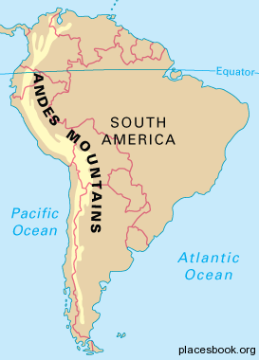
© Brain Wrinkles

Slide 29
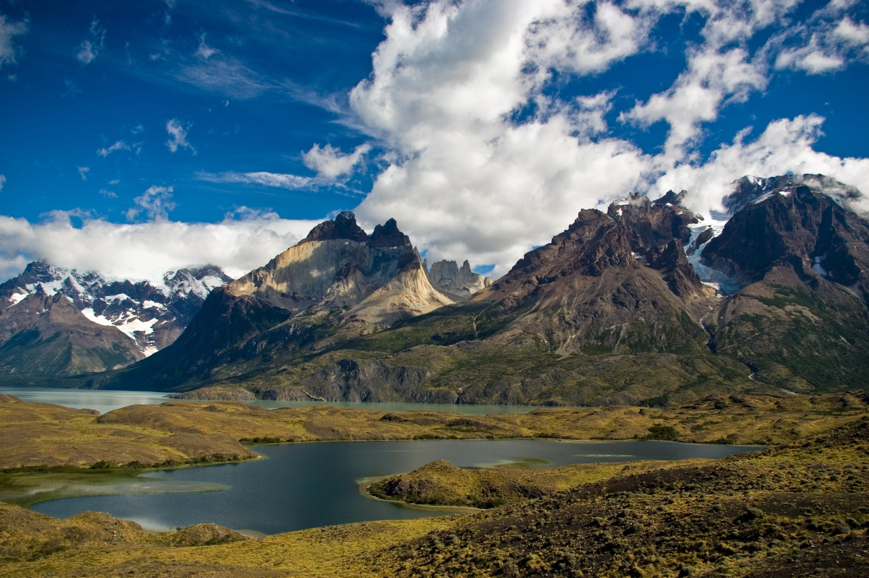
© Brain Wrinkles

Slide 30
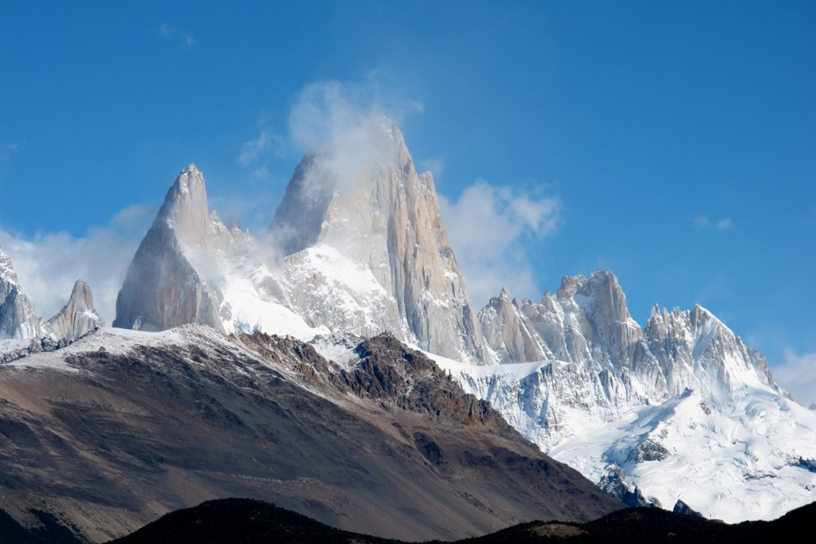
© Brain Wrinkles

Slide 31
Sierra Madre
Mountains
A mountain system comprised of 3 mountain ranges located primarily in Mexico.
Three major chains: the Sierra Madre Occidental in the west, the Sierra Madre Oriental in the east, and the Sierra Madre del Sur, which extends along the southern coast.
The Sierra Madre range contains some of the highest mountains and volcanoes in Latin America.
© Brain Wrinkles

Slide 32
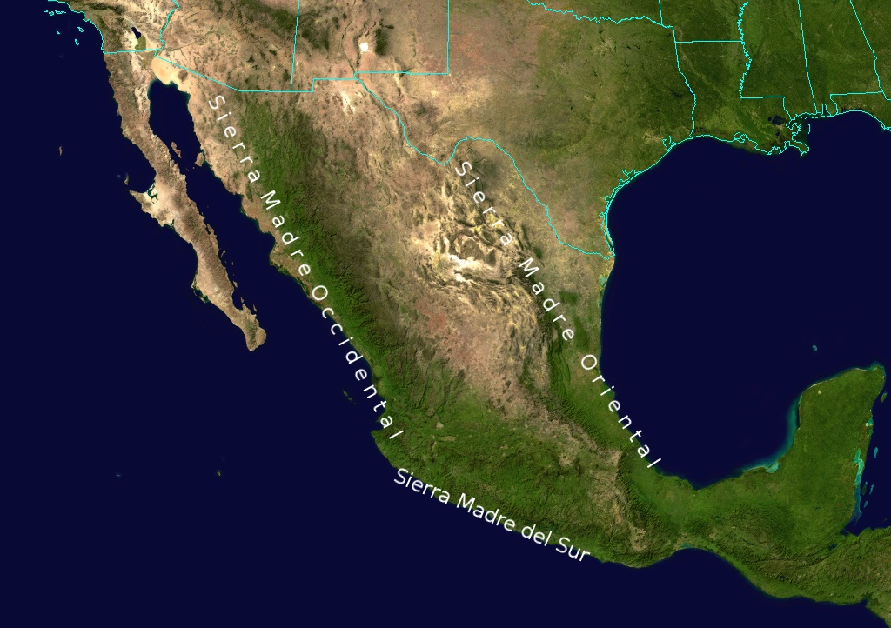
© Brain Wrinkles

Slide 33
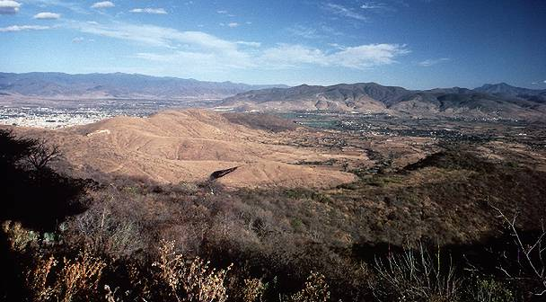
© Brain Wrinkles

Slide 34
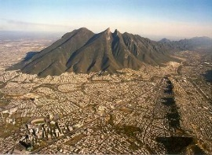
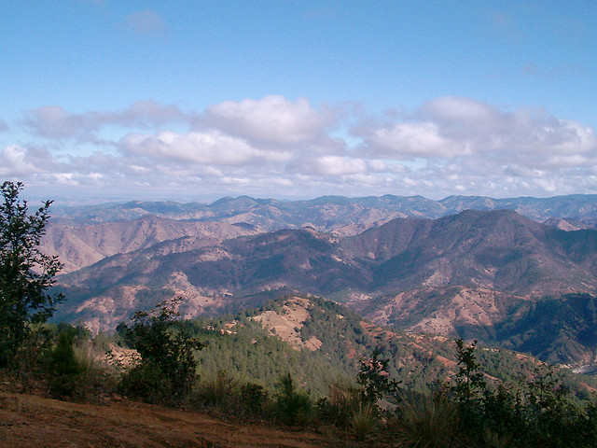
© Brain Wrinkles

Slide 35
Atacama Desert
It is located in the Andes of Chile.
It’s one of the driest places on earth; very little rainfall year round and has a cold climate.
© Brain Wrinkles

Slide 36
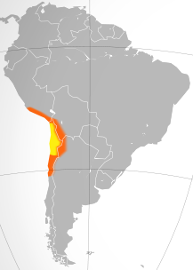
© Brain Wrinkles

Slide 37
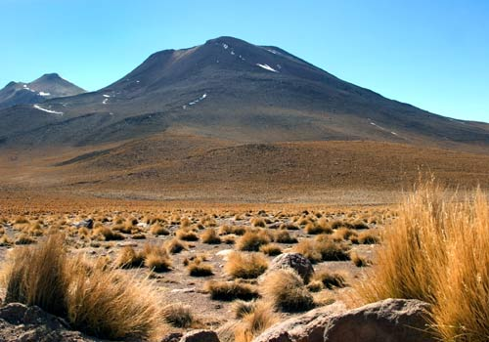
© Brain Wrinkles

Slide 38
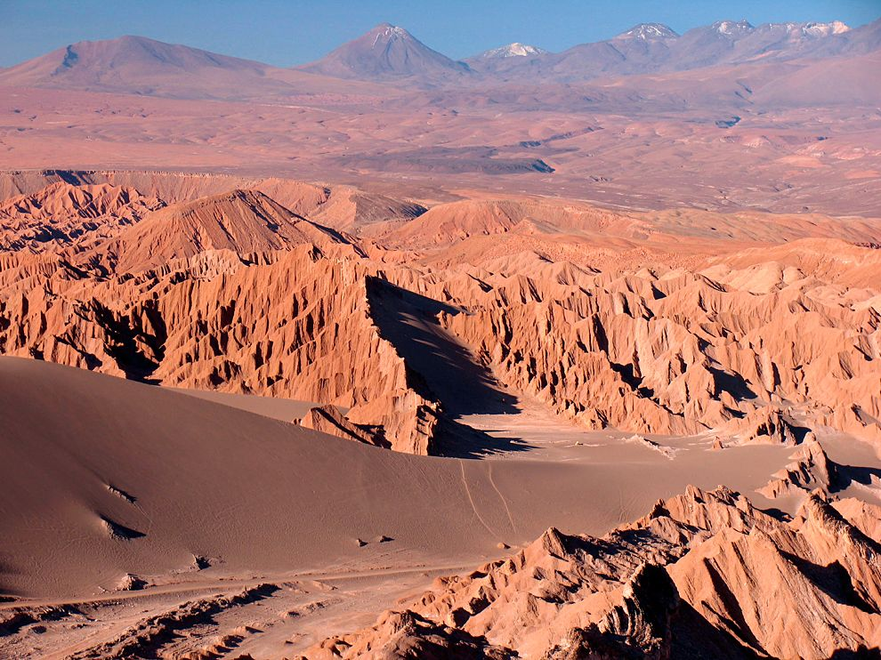
© Brain Wrinkles

Slide 39
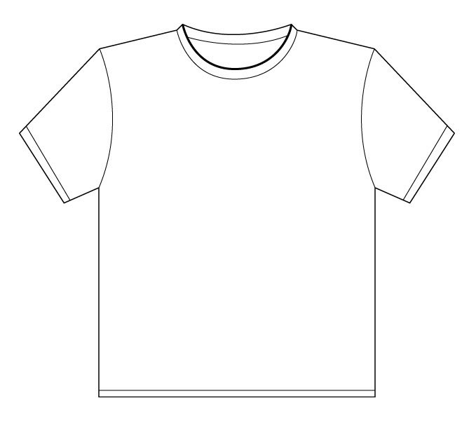
Name:
Name:
Souvenir Shirt
Souvenir Shirt
Design a t-shirt that represents your favorite physical feature from the lesson.
Design a t-shirt that represents your favorite physical feature from the lesson.
© Brain Wrinkles
© Brain Wrinkles

