Slide 1
Major Religions in Europe
Standard SS6G10
b. Identify the major religions in Europe: Judaism, Christianity, and Islam.

Slide 2
Why do people have a religion?

Slide 3
Remember…
BCE= before common era, before the year 1
(used to be BC= Before Christ)
CE= Common Era, after the year 1
(used to be AD= Anno Domini, Latin for “in the year of the Lord”)

Slide 4
Remember…
There are over 7.4 billion people in the world.

Slide 5
Monotheistic Religions
Belief in only ONE God
All of the major religions in Europe are monotheistic

Slide 6
Major Religions in Europe:
Christianity
Judaism
Islam

Slide 7
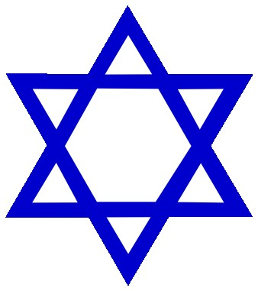
Judaism
15 million followers (called Jewish)
Basic beliefs: Obey God's commandments; live ethically. Focus is more on this life than the next. Synagogue services on Saturdays. No pork or other non-kosher foods.
Founder: Abraham (about 2000 BCE)
Oldest, but least practiced
Holy book: Torah and Talmud
(Torah is the 1st 5 books of the Old Testament)
House of Worship: Synagogue
Holy Days:
Rosh Hashanah
Jewish New Year’s Day
Yom Kippur
Day of Atonement

Slide 8
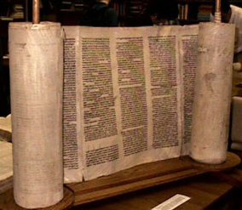
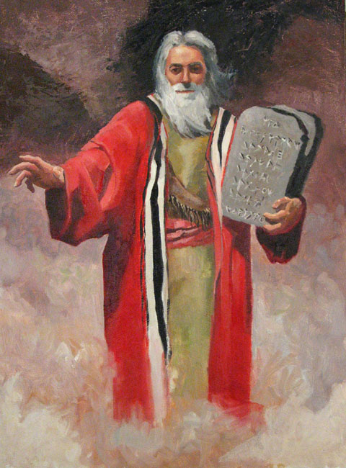
Moses
The Torah
© Brain Wrinkles

Slide 9
Largest Synagogue in Europe

Slide 10
Christianity
2.1 Billion followers (called Christian)
Basic beliefs: Based on the teachings of Jesus, love of God and neighbor, a regard for justice, and belief that Jesus is the Son of God, prayer, Bible study, communion, church attendance
Founder: Jesus Christ (about 30 AD)
Most practiced in Europe today
Holy book: Bible
House of Worship: Church
Holy Days:
Christmas
Birth of Christ
Easter
Resurrection of Christ

Slide 12
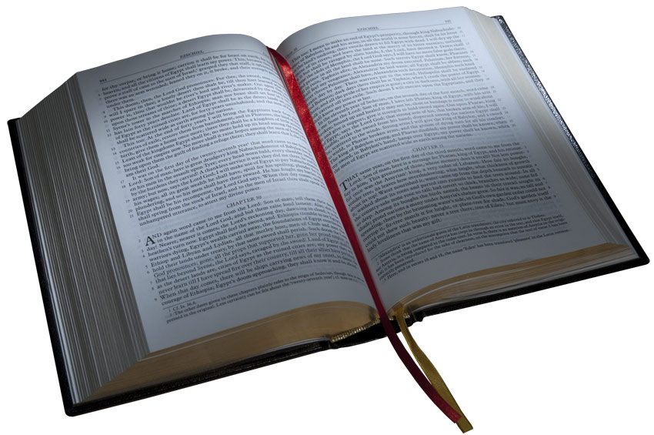
The Bible
© Brain Wrinkles

Slide 13
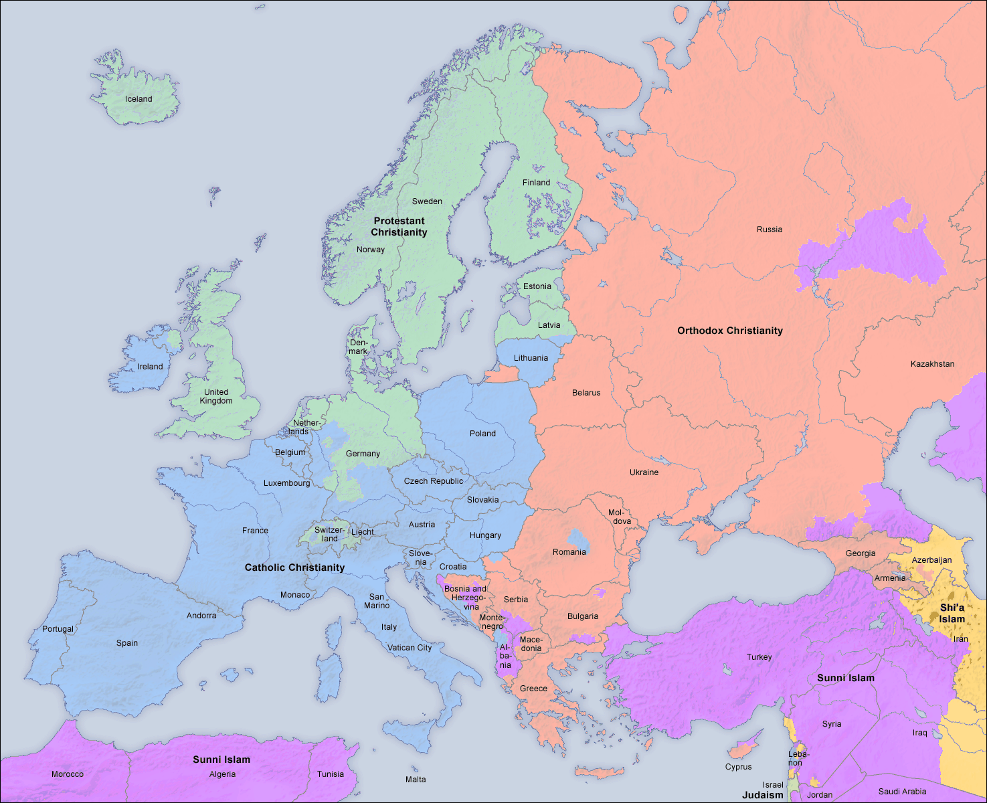
Protestant
Orthodox
Judaism
Catholic
Islam
Notes:
Green=Protestant blue=Roman Catholic pink=Orthodox Christianity purple=Islam Stars indicate Judaism----France has one of the largest populations of Judaism of all the European countries.

Slide 14
Protestant Christianity
Orthodox Christianity
Catholic Christianity
All three were founded by Jesus.
All three use written book –Bible.
All three believe in one God.

Slide 15
Islam
1.3 Billion followers (called Muslim)
Basic beliefs: prayer, giving to charity, belief in and submission to Allah, fasting during Ramadan, a trip to Mecca once during your lifetime
Founder: Muhammad (about 610 AD)
Fastest growing religion
Holy book: Qur’an (Koran)
House of Worship: Mosque
Holy Days:
Eid ul Fitr
Ends Ramadan (a month of fasting)
Eid ul Adha
Marks the end of the holy pilgrimage

Slide 16
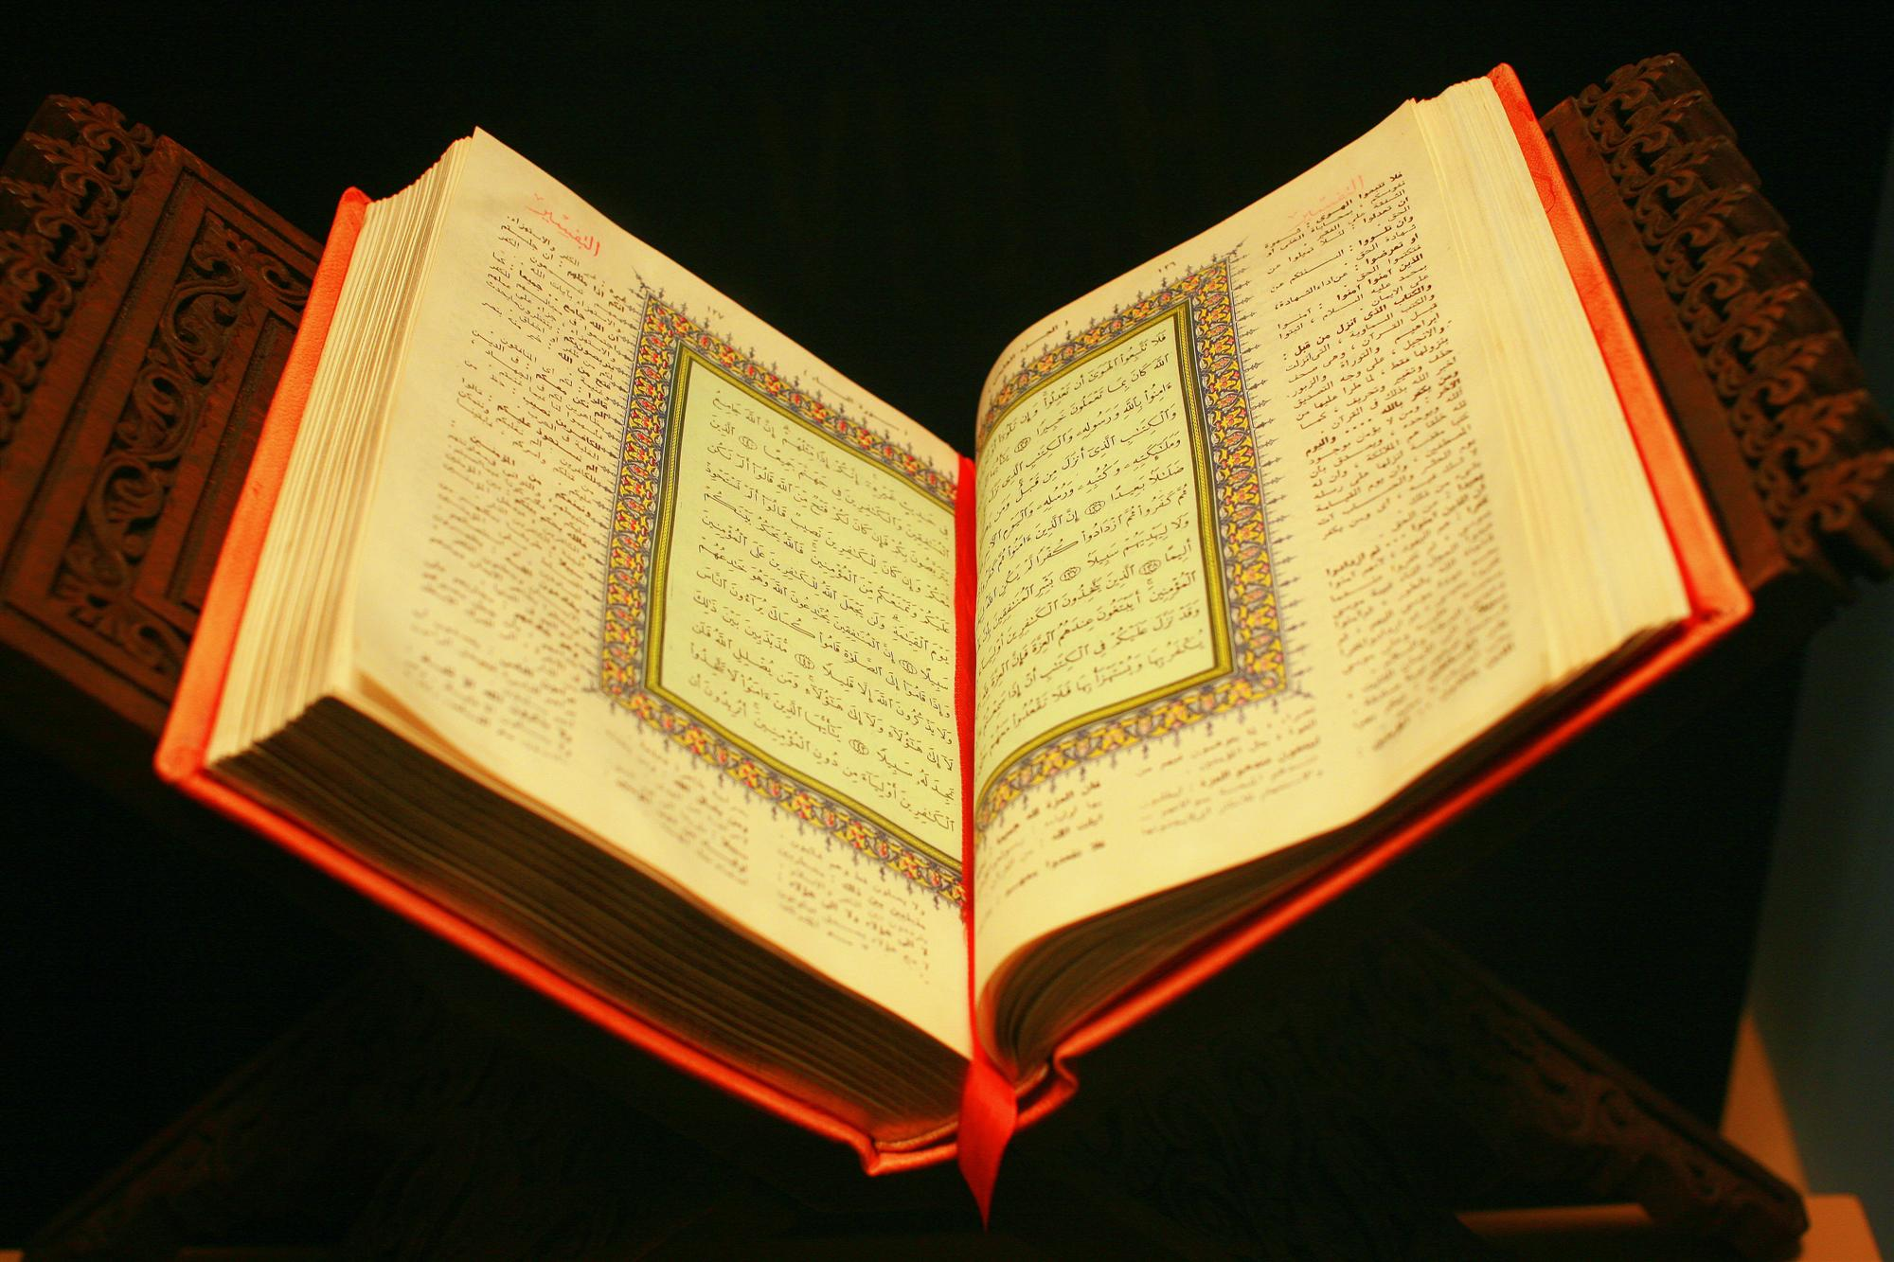
The Qur’an (The Koran)
© Brain Wrinkles

Slide 17
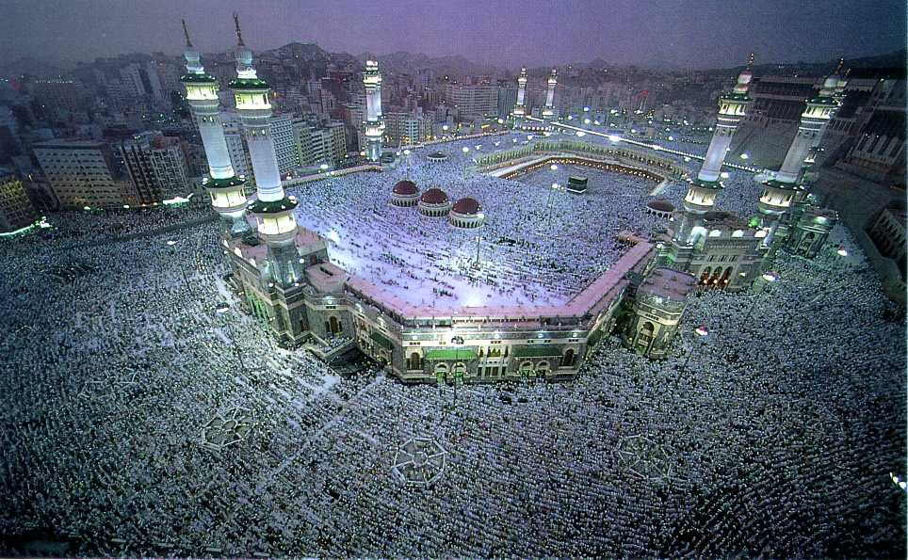
The Grand Mosque in Mecca
© Brain Wrinkles

Slide 18
Similarities
All three believe in one god (monotheistic).
They all started in Southwest Asia.
They can trace their roots to Abraham as the father of their faith.
Jerusalem, Israel is the holiest city in the world for Jews and Christians, and the third holiest city for Muslims.
All three have an important messenger and book of teachings.
© Brain Wrinkles

Slide 19
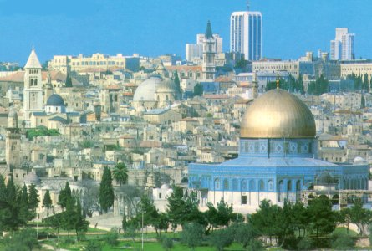
Jerusalem, Israel
© Brain Wrinkles

Slide 20
Review:
What is the oldest of the three main European religions?
Which religion is growing the fastest?
Name a way all three religions are similar.
Match the texts and the religions correctly:
Religions= Judaism, Christianity, Islam
Texts= Bible, Qur’an, Torah & Talmud

