Slide 1
Languages Walk
Follow the directions on your sheet quietly.
© 2014 Brain Wrinkles

Slide 2

1
Hallo! Ich bin froh dass Sie in meiner Gemeinschaftskunde-Klasse sind. Auf Wiedersehen!
© 2014 Brain Wrinkles

Slide 3
2
Olá! Estou contente de que você esteja na minha classe de Estudos Social. Adeus!
© 2014 Brain Wrinkles

Slide 4
3
¡Hola! Me alegro de que usted esté en mi clase de Estudios Social. ¡Hasta la vista!
© 2014 Brain Wrinkles

Slide 5
4
Здравствуйте! Я рад, что Вы находитесь в моем классе Общественных наук. До свидания!
© 2014 Brain Wrinkles

Slide 6
5
Bonjour! Je suis heureux que vous soyez dans ma classe de Sciences humaines. Au revoir!
© 2014 Brain Wrinkles

Slide 7
6
Ciao! Sono contento che tu sia nella mia classe Studi Sociali. Arrivederci!
© 2014 Brain Wrinkles

Slide 8
Languages Walk
Let’s see if you guessed correctly!
1. German
2. Portuguese
3. Spanish
4. Russian
5. French
6. Italian
© 2014 Brain Wrinkles

Slide 9
What Did They Say?
Hello! I'm glad that you're in my Social Studies class. Goodbye!
© 2014 Brain Wrinkles

Slide 10
EUROPEAN LANGUAGES
SS6G10 Describe selected cultural characteristics of Europe.
A. Describe the diversity of languages spoken in Europe.

Slide 11
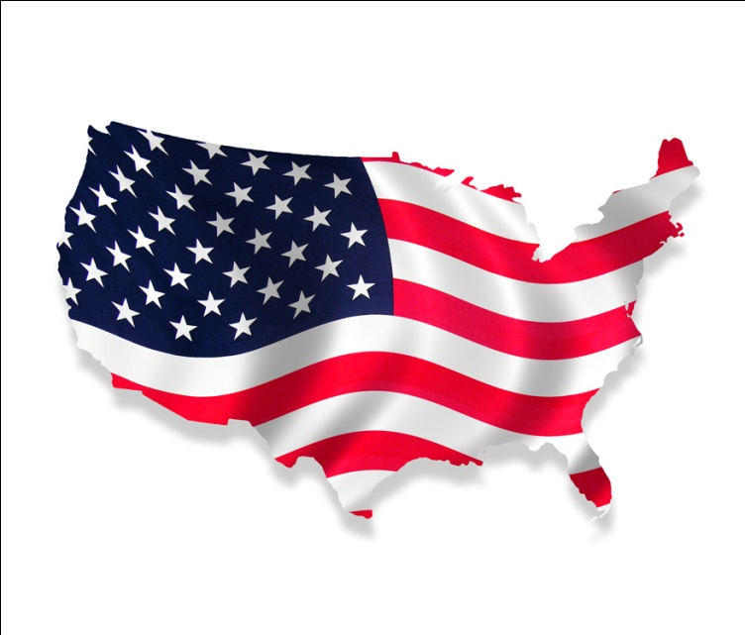
1
In the United States,
English is the one
dominant language.
200+
In Europe, there are over 200
native languages!!

Slide 12
What does it mean to be a native speaker of a language?
A native speaker has spoken that language since early childhood.

Slide 13
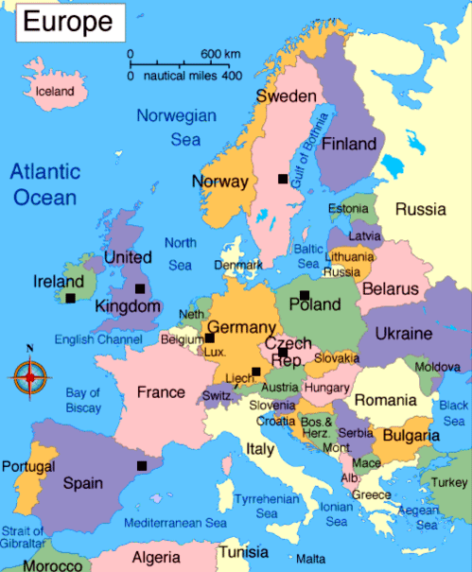
Most languages of Europe can be categorized by their origin- or where and when they started.

Slide 14
European Languages
Most European languages are in 3 main language families (or categories):
  Germanic,
  Romance, &
  Slavic
© 2014 Brain Wrinkles

Slide 15
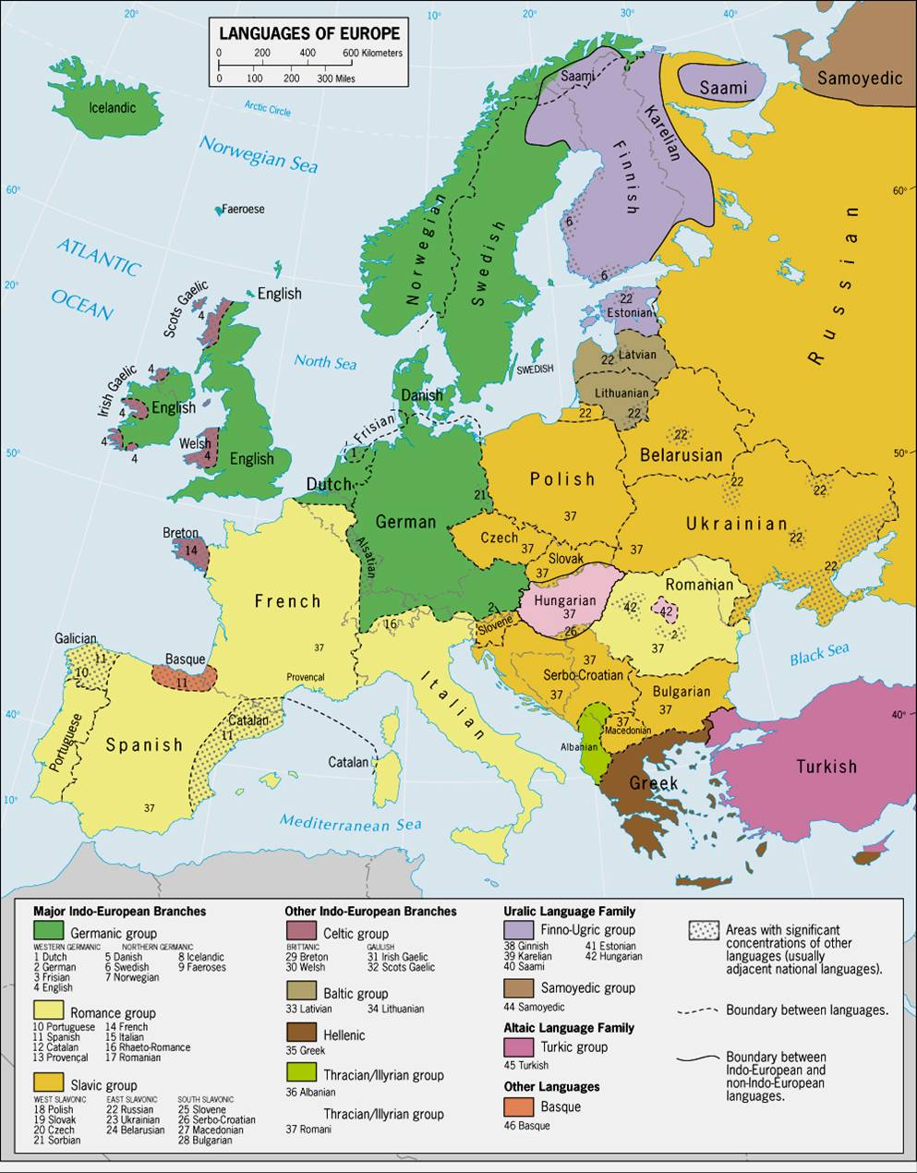
Green- Germanic languages
Beige- Romance languages
Orange- Slavic languages

Slide 16
Germanic Language Family
Has the most native speakers
Most live in northwest and central Europe
English & German are part of this family
  About 20% of Europeans speak one of these two languages
Most Europeans learn English as a 2nd language in their schools
© 2014 Brain Wrinkles

Slide 17
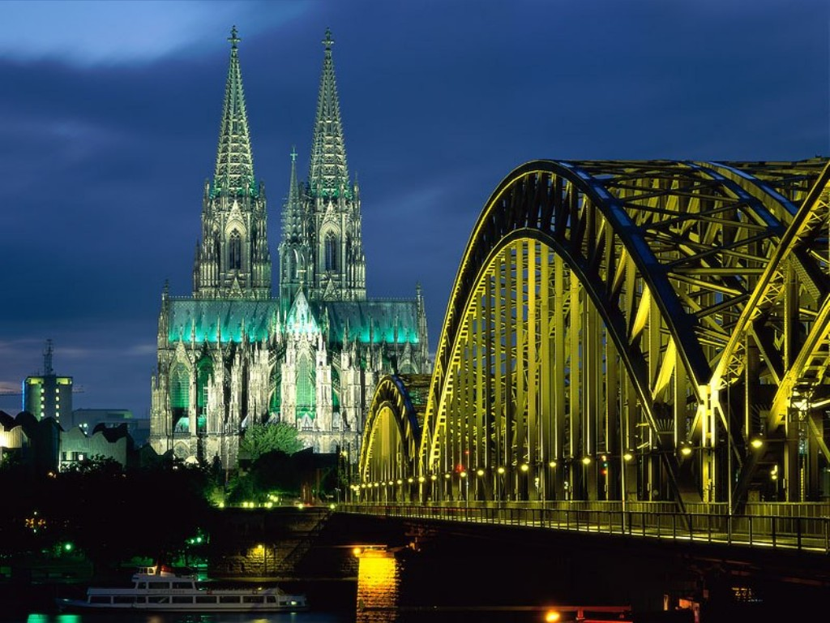
Germanic
English and German (use the Roman alphabet)
  Guten Morgen
    goot-en mor-gen
    Good Morning
  Guten Tag
    goot-en tahk
    Hello/Good Day

Slide 18
German Clip
http://cleanvideosearch.com/media/action/yt/watch?videoId=KO9DAnw39do

Slide 19
Romance Language Family
Includes French, Italian, & Spanish
Most live in the south and west of Europe
These languages come from Latin, the language of the ancient Roman Empire
  Romance Languages
© 2014 Brain Wrinkles

Slide 20
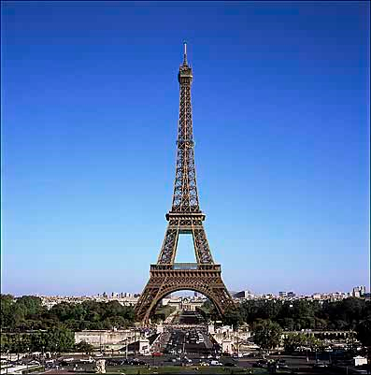
ROMANCE
French and Italian (use the Roman Alphabet)
  Bonjour
    Hello / Good day / Good morning
  Ciao
    Hi / Hello / Bye

Slide 21
Italian Clips
https://youtu.be/8JsdiTiowGM
https://youtu.be/Bpa7wwYyPR8

Slide 22
French Clip
https://youtu.be/yvEr0fqYWs0

Slide 23
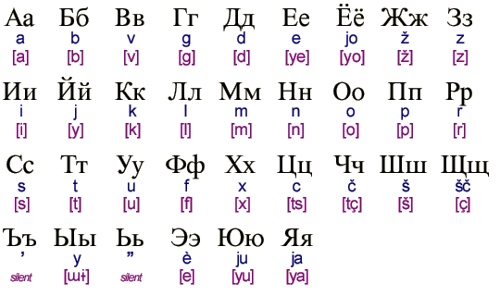
Slavic Languages
Includes Russian
Found in central and eastern Europe
Written with a Cyrillic alphabet
© 2014 Brain Wrinkles

Slide 24
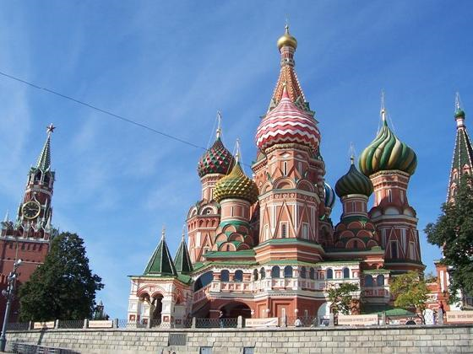
SLAVIC
  Russian
  До свидания
    duh-svee-dah-nya
    Good Bye
  Нет
    Nyet
    No

Slide 25
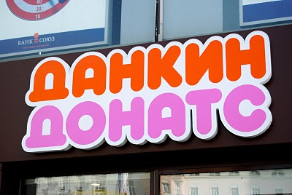

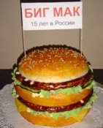

SIGNS USING THE CYRILLIC ALPHABET:

Slide 26
Russian Clips
https://youtu.be/Q7C2MKoBL7Q
https://youtu.be/FMKwq-mQVgo

Slide 27
Brain Break!
If possible, write your name using the Cyrillic alphabet.
© 2014 Brain Wrinkles

Slide 28
Diversity in European Languages Today
Many countries have more than one official language
  Part of life in many countries in Europe due to the ethnic background of the people living there
Many countries share borders, and people move back and forth across borders
  About 400 million people in the world speak English because it is often the choice for a 2nd language
  Over ½ of all Europeans speak English
© 2014 Brain Wrinkles

Slide 29
Having so many languages can be a problem
Difficult to live, work, and trade with people who cannot communicate with each other
So…
  School children learn 1 or 2 other languages besides their own.
  European Union has 23 “official” languages to make sure that people can understand laws and decisions made by the government.
© 2014 Brain Wrinkles

Slide 30
Classify Your Language Chart into Language Families…
Germanic
Romance
Romance
Slavic
Romance
Romance
© 2014 Brain Wrinkles

Slide 31
How are the languages of French and Italian similar?
The two countries are close to each other.
Both languages are Romance Languages.
They share roots of Germanic languages.

Slide 32
Which major European language origin has the largest number of speakers?
A. Germanic
B. Romance
C. Slavic

Slide 33
3. What have Europeans done to solve the problems presented by so many different languages?
A. They do not trade with people who do not speak the same language.
B. Made laws that proclaim English is the only official language of the EU.
C. Require students in school to learn at least two languages.

Slide 34
4. Which language(s) come from the ancient Roman Empire?
A. English and Dutch
B. Russian and Polish
C. Latin
D. French, Italian, Spanish

