Slide 1
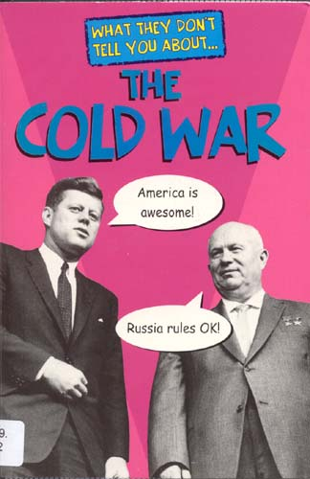
The
Cold War Study Guide

Slide 2
Standard SS6H7: THE STUDENT WILL EXPLAIN CONFLICT AND CHANGE IN Europe to the 21st century.
b. Explain the origins of the Cold War and the rise of Superpowers.
c. Explain how the collapse of the Soviet Union led to the end of the Cold War and German reunification.

Slide 3
Origins of the Cold War
The Cold War began after WWII ended in 1945.
Two opponents in the Cold War were the communists and anti-communist nations of the world.
The two opposing superpowers – the USA & the Soviet Union became enemies in 1945 because their beliefs & objectives were completely opposite.

Slide 4
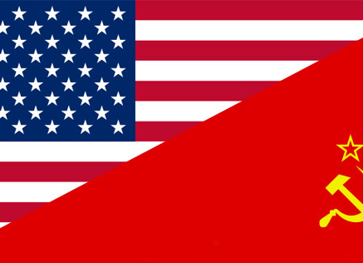
The philosophical conflict between these two countries became known as the Cold War.

Slide 5
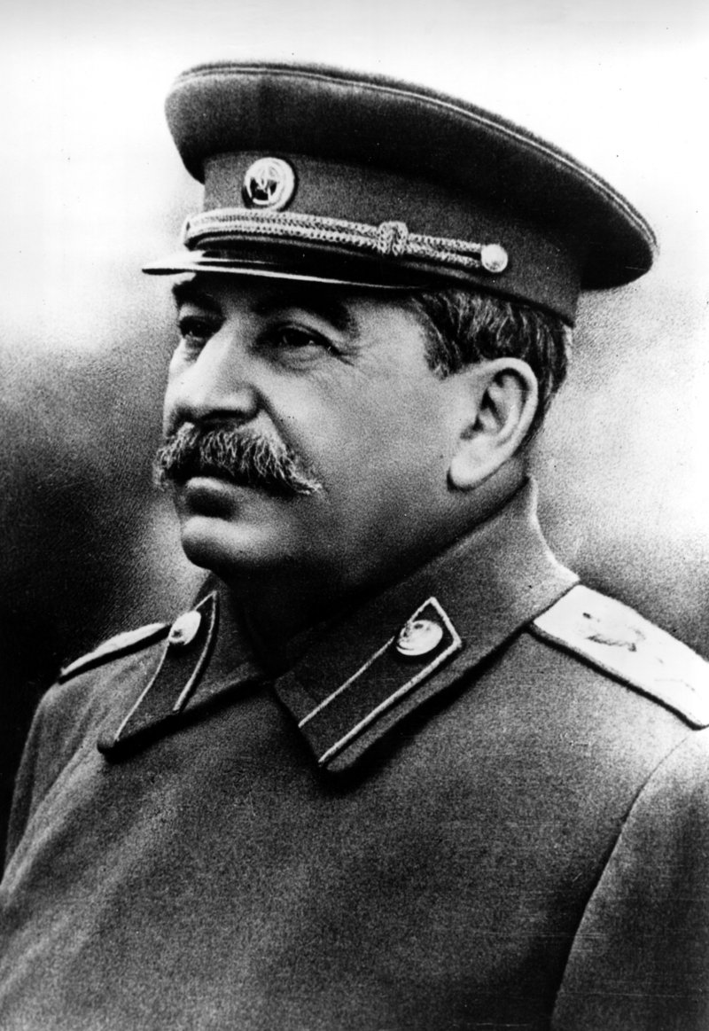
Cold War – Early Years
Soviet Union leader, Joseph Stalin placed most eastern European countries under communist control.
These countries became known as the Eastern Bloc.
A bloc is a group of nations “united” under a common idea or purpose.

Slide 6
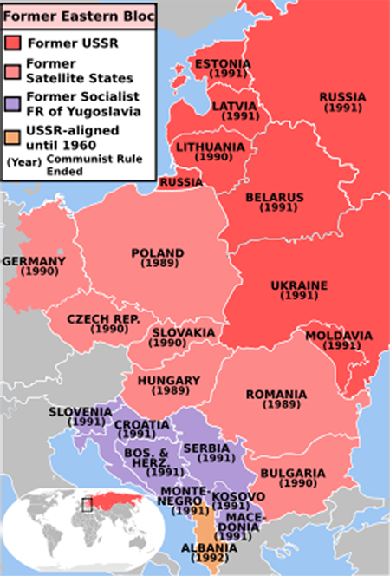
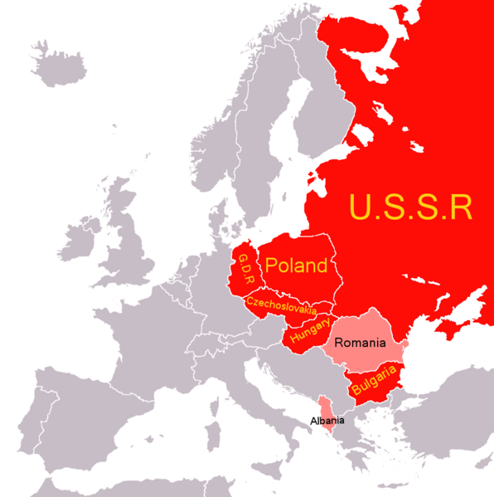
Eastern Bloc countries

Slide 7
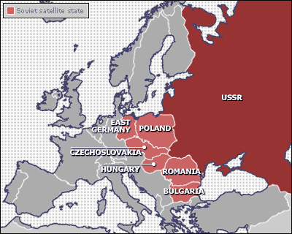
Cold War – Early Years
The USA led the western European countries that became known as the Western Bloc.
Gray countries are part of the Western Bloc.

Slide 8
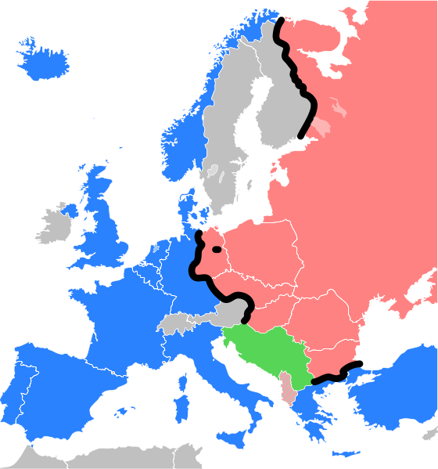
Cold War – Early Years
The line dividing western and eastern blocs became known as the “Iron Curtain”.

Slide 9
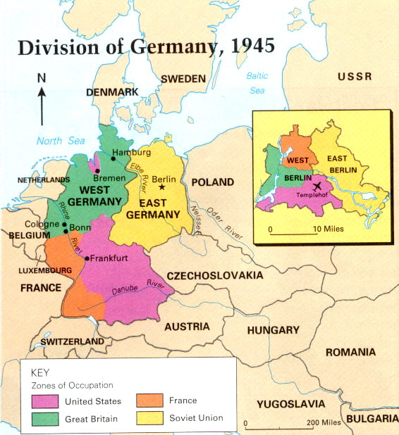
Division of Germany
At the end of WWII, the Allies divided Germany into four sections to keep it from regaining power.
1948, western allies wanted to reunite Germany, Soviet Union disagreed.
They declared their section “East Germany.”

Slide 10
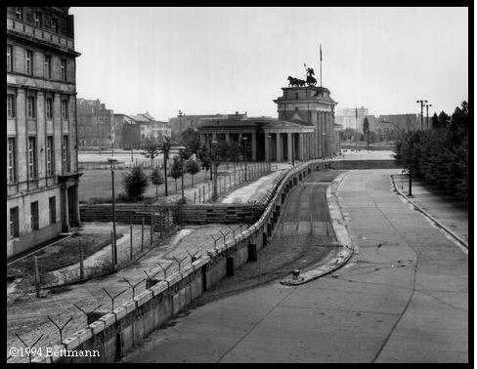
Division of Germany
The western sections became “West Germany.”
Even the capital of Berlin in East Germany was divided into East and West.
Tensions grew & in 1961, communist leaders built the Berlin Wall, separating the communist East Berlin from “free” West Berlin.

Slide 11
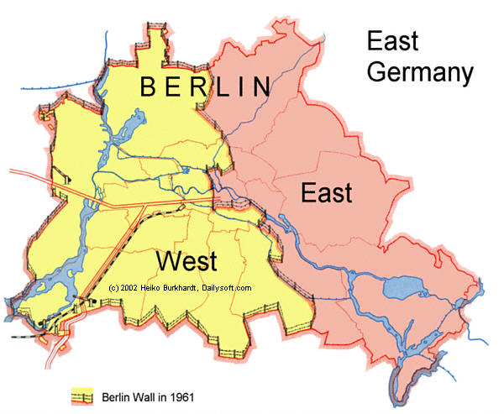
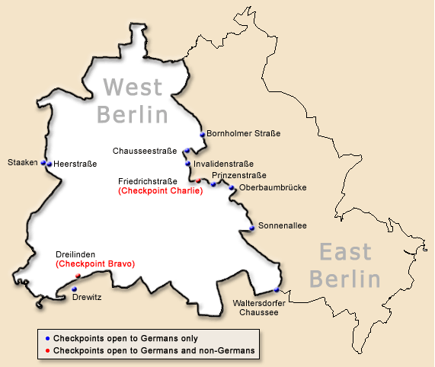
Berlin Wall

Slide 12
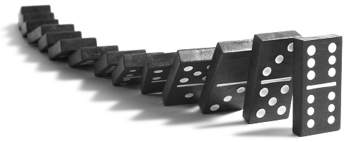
Growing Fear
Each side during the Cold War thought the other was trying to rule the world.
People lived in fear that if a war happened it would be a nuclear war.
Countries formed alliances to protect one another. The U.S. worried about the “Domino Effect”.
In 1949, the western European countries plus the USA and Canada formed the North Atlantic Treaty Organization (NATO).
The eastern bloc countries signed the Warsaw Pact.

Slide 13
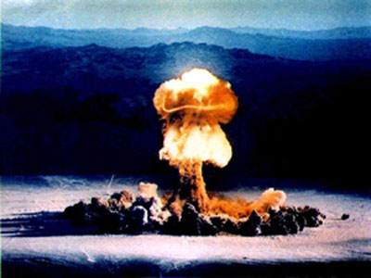
Nuclear Tensions
The USA had shown its atomic power when it exploded the A-bombs on Hiroshima and Nagasaki at the end of World War 2.
The USSR was also developing atomic weapons/bombs.
The USA and the USSR were in competition with each other to have the best, most powerful weapons in the world – this was called the Arms Race.

Slide 14
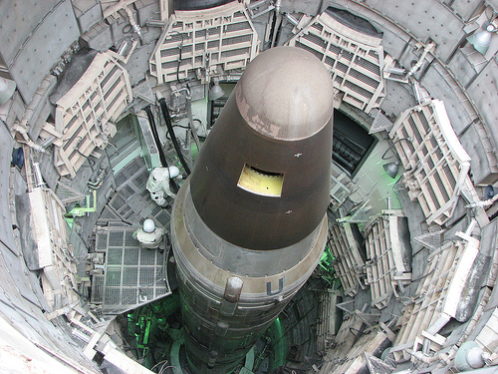
Everything was a race!!
Both countries also
competed for space
exploration.
This was called the
Space Race.

Slide 15
The Cold War Turns Hot
There were “hot” wars that occurred during the Cold War time period.
“Hot” war means that fighting/armed conflict did occur.
Do you recognize any of these conflicts/regional wars?
  North America – Cuban Missile Crisis, Guatemala, El Salvador, and Nicaragua
  South America – Chile
  Europe – East Germany
  Africa – Ethiopia, Angola, and Congo
  Asia – Afghanistan, Indonesia, Korean War, Vietnam War

Slide 16
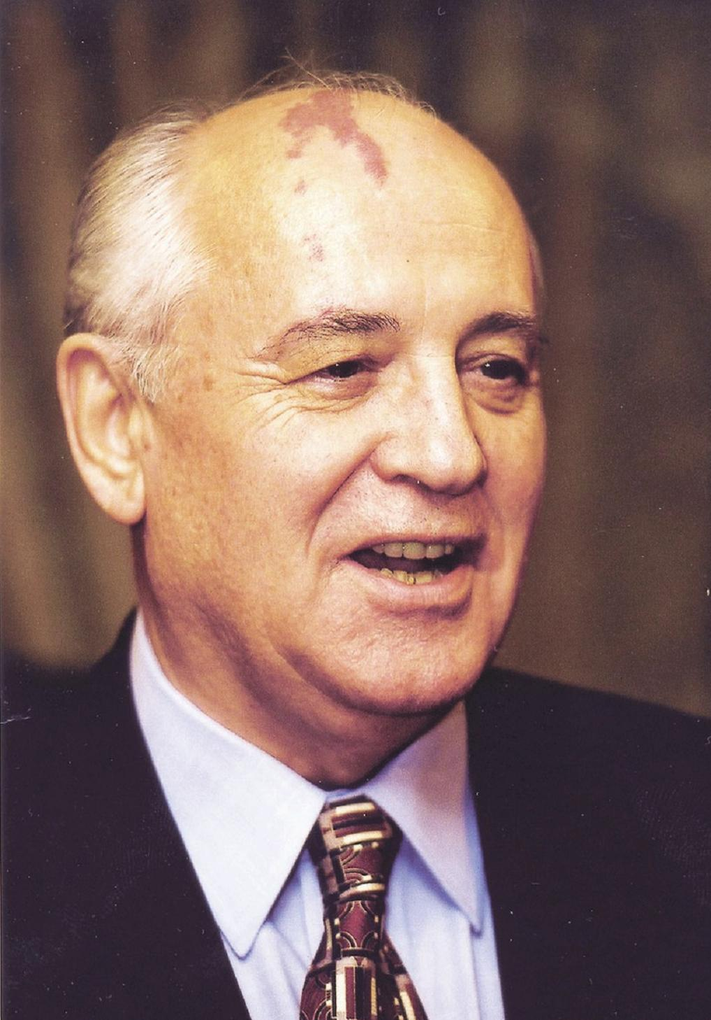
Collapse of the Soviet Union
Near the end of the Cold War, the Soviet Union was spending more and more money putting down revolts within its own country, protecting its borders, and keeping up with the USA. The citizens felt the effects of the struggling command economy.
By 1985, the Soviet government was very unstable and there were mass reductions in Soviet government and economy by their leader Mikhail Gorbachev, meaning people were gaining more freedoms!

Slide 17
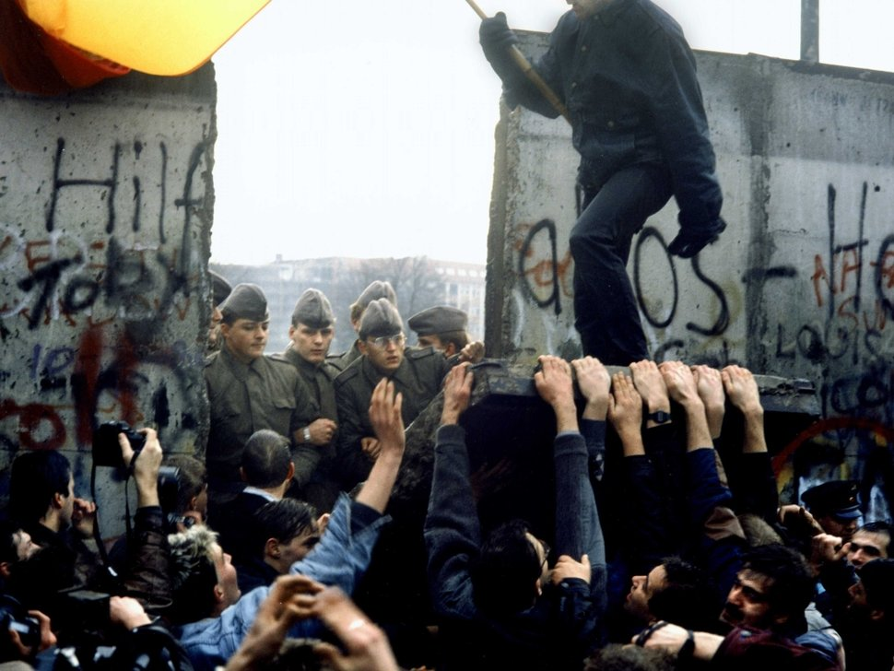
Fall of the Berlin Wall
In November of 1989, the Berlin Wall was torn down, and Germany began the process of unifying.
East and West Germany were made one country in 1990. This was symbolic of the fall of communism.

Slide 18
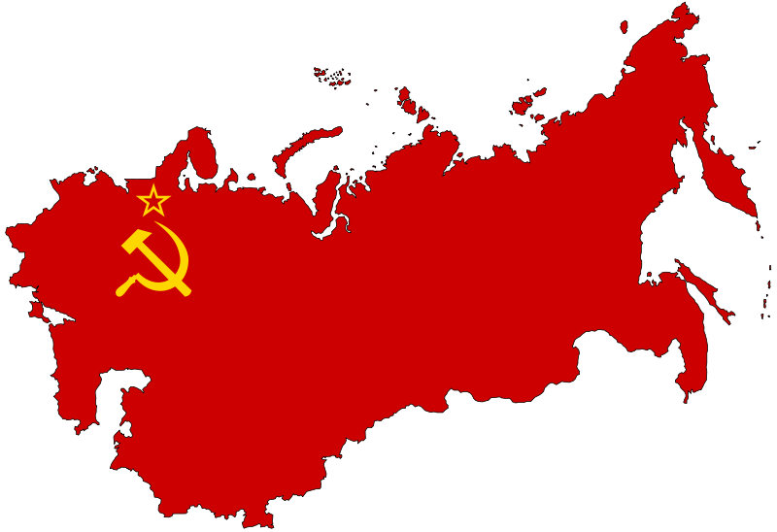
Final Collapse of the Soviet Union
Throughout 1989 and 1990, the Soviet Union began separating into independent nations and by 1991, the Soviet Union was no more.
Many new countries came into existence and Russia was the largest country to come from the Soviet Union.
The Cold War was over.

Slide 19
Why was it called the Cold War?
There was never a real war between the two superpowers, although both sides got involved in other conflicts in the world to help or to stop the spread of communism.
The Cold War lasted for 45 years!!!
(1945-1990)

Slide 20
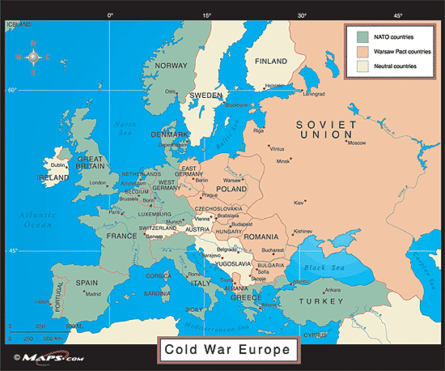

Slide 21
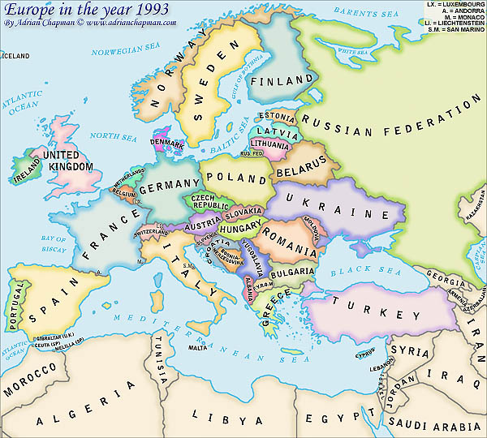
Post Cold War Europe

Slide 22
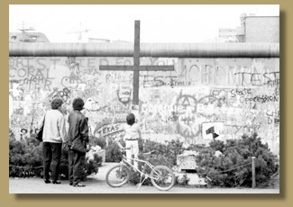
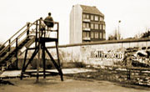
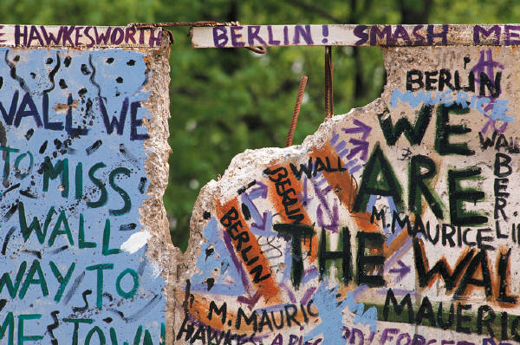
The Berlin Wall

Slide 23
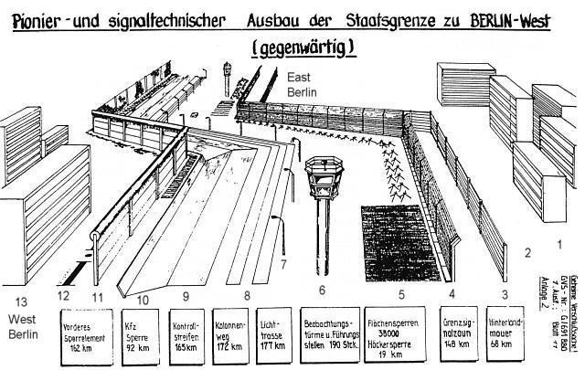
A sketch of the different sections of the Wall
Notes:
#1 is East Berlin #2 is the border area #3 is the backland wall #4 is the signal fence #5 is different types of barriers #6 is the watch towers #7 is the lighting system #8 is the column track #9 is the control track #10 is the anti-vehicle trenches #11 is the last wall, known as the “Wall” #12 is the border #13 is West Berlin

Slide 24
The Berlin Wall
The whole border area was on the territory of East Berlin/East Germany.
The border between East and West Berlin was after the last wall.
The last wall is known as the “Berlin Wall”.
The Wall was a complex system of walls, fences, watchtowers and different barriers.

Slide 25
The area between the Backland Wall (#3) and the Last Wall (#11) was referred to as the “Death Strip”

Slide 26
Facts about the Berlin Wall
65 miles of anti-vehicle trenches
79 miles of signal fencing
There were 302 watch towers
Approximately 193 people were killed and 200 injured while attempting to cross
Total length = 110 miles

Slide 27
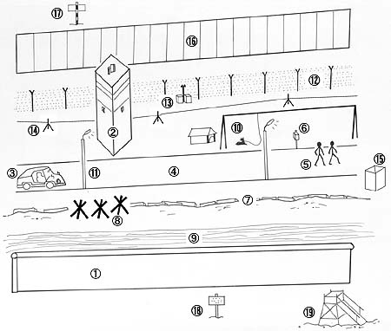
Label your diagram as you look at the following slides.

Slide 28
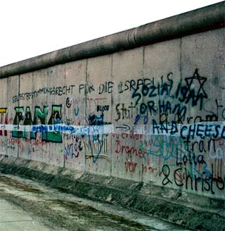
Wall
(front side-facing West Berlin )
Concrete wall used since 1976
In August 1961, this barrier was only made of barbed wire.
This was the part referred to as the “Berlin Wall"
Round tube installed on top -- why?

Slide 29
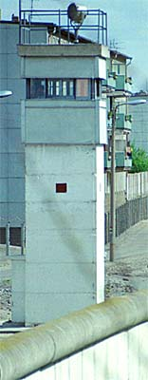
Watch Tower
Occupied by two guards
Equipped with a searchlight on top
Newer towers like this one were constructed in the 1980s.
Equipped with a phone inside and it also contained all electrical controls for the wired fences.

Slide 30
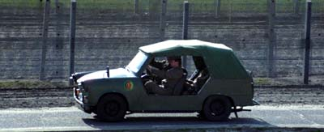
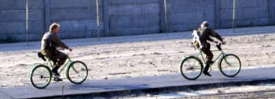
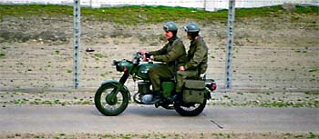
Patrol
Guards not only patrolled in the watch towers but in jeeps,
on bicycles,
and on motorcycles.

Slide 31
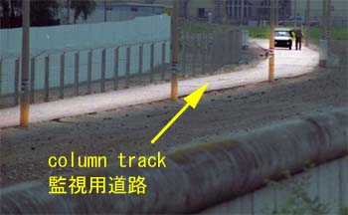
Column track
The column track was a military road for the guards only. It was coated with asphalt and so narrow that only one car could use it at a time.

Slide 32
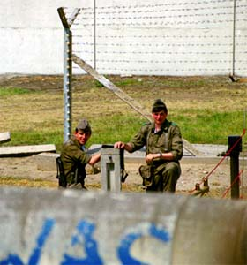
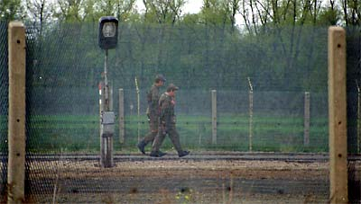
Soldiers
(Guards)
Besides watching from towers and patrolling in vehicles, guards walked around and stood in "no- man's-land".

Slide 33
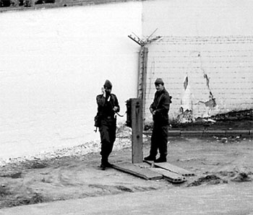
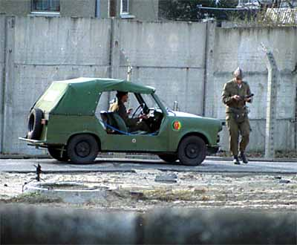
Telephone
The guards reported to their boss on a wire telephone. The East German regime did not trust their own soldiers and would not equip them with a radiophone. Radiophones could possibly allow the guards to get in contact with somebody in West Berlin. But with a wired telephone they could call only certain people.

Slide 34
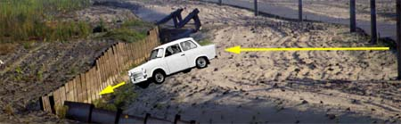
Anti-Vehicle Trench
This section obstructed an escape by car. It was a trench dug about 1 meter deep and concrete panels were on one side. When somebody tried to escape in a vehicle, the vehicle fell into the trench and could not move.

Slide 35
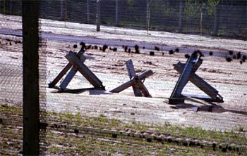
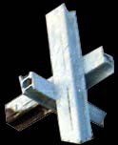
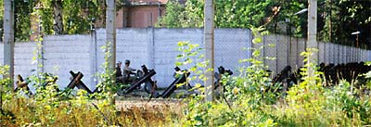
There were places where the anti-vehicle trench did not exist. This was so the guards could have access to the front Wall for repairs. At these "security holes“ they would put these barricades.
Barricades

Slide 36
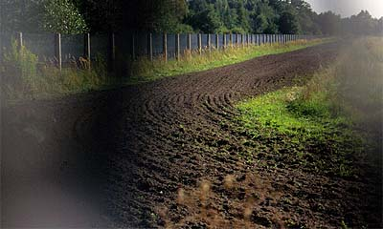
Stripes
This photo was taken through the wire mesh fence. The ground was weeded and shaped with stripes so that footmarks could be found easier if an escape occurred.

Slide 37
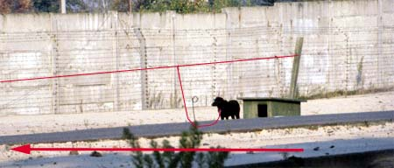
Dogs
In the "no-man's-land" area, there were many dogs stationed to alert the guards if somebody was crossing over the Wall. The dog was able to run along the column track while hooked to his lead.

Slide 38
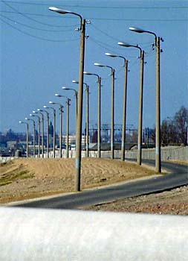
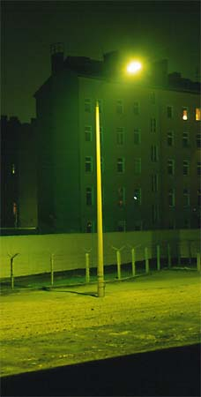
Light masts stood along the column track

Slide 39
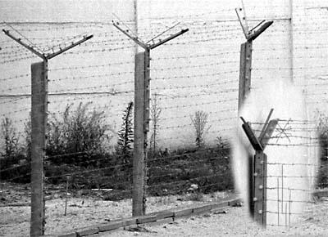
24 electrical wires were connected to each other by cables. When somebody touched two wires or cut a wire, the flow of electricity was changed and an alarm was given. The alarm was sent to the command tower and guards knew which sector had been affected.
Electrical Barbed Wire

Slide 40
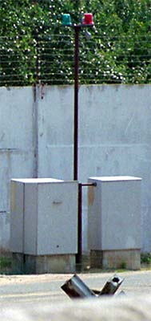

The boxes contained a device connected with the electrical barbed wires to signal an alarm. When the alarm was given in the watch tower, the lights on top of the pole flashed and a siren was heard.
Alarm Box

Slide 41
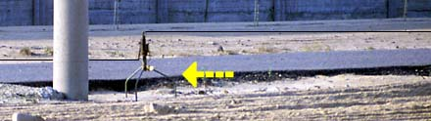
Trip wires were set about 30-50cm high and hooked with a signal fire called "PSG-80". When a wire was tripped, a cartridge filled with gunpowder was ignited and it made a loud noise along with a flash of light. This would alert the guards nearby.
Wires with signal fire

Slide 42
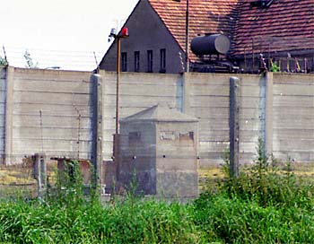
This was a watch bunker made from concrete, about 1 meter square, and had small windows. Guards were inside to watch the area called “no-man's-land”.
Bunker

Slide 43
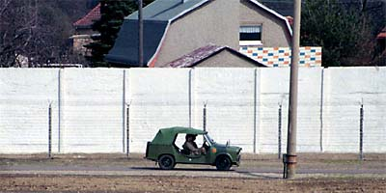
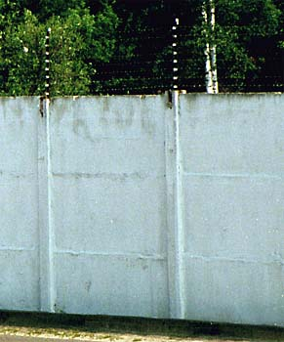
The inside of the Wall was usually painted white so guards could easily detect the movements of someone trying to escape.
Background of wall

Slide 44
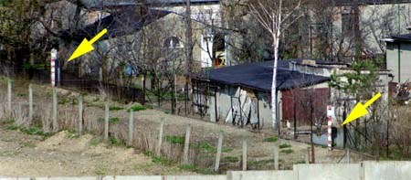
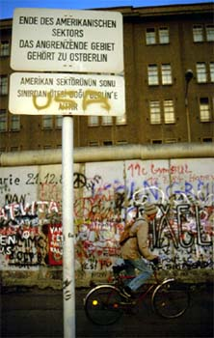
These signs warned that no citizen may go into the border area.
Eastern side signs
Western side
signs

Slide 45


The platforms stood along the Wall in West Berlin so that citizens and tourists could see the other side of the city. Of course there was nothing like this in East Berlin.
Platform (Western Side)

Slide 46
Additional pictures of The Berlin Wall

Slide 47


Slide 48


Slide 49


Slide 50


Slide 51

Check-point Charlie

