Slide 1
Australia’s History, Government, & Economy

Slide 2
Standard SS6H4
Explain the impact of English colonization on current Aboriginal basic rights, health, literacy, and language.

Slide 3
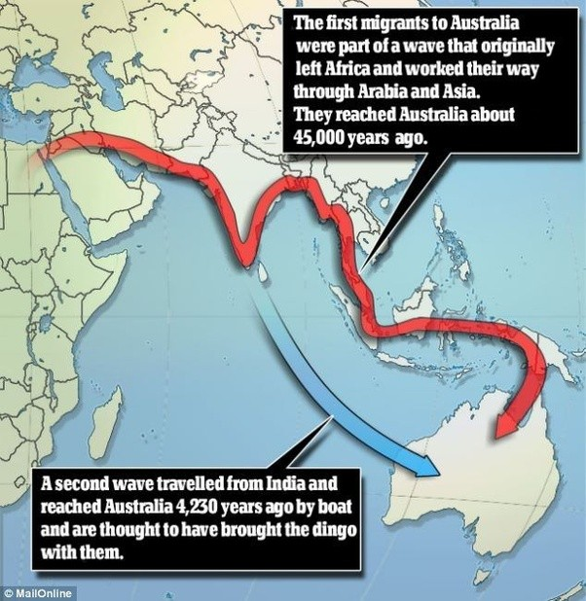
Australia’s History
The earliest
inhabitants
of Australia
were the
Aboriginal
people.

Slide 4
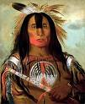
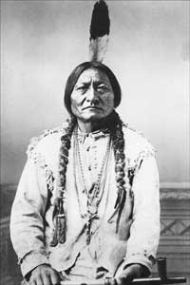
Think about it!
The Aborigines of Australia are similar to what group of people in North America?
HINT:

Slide 5
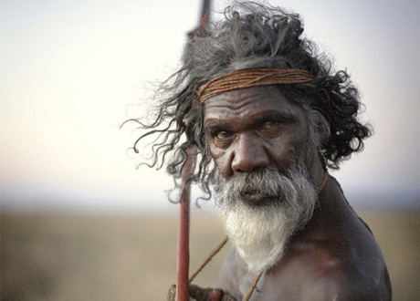
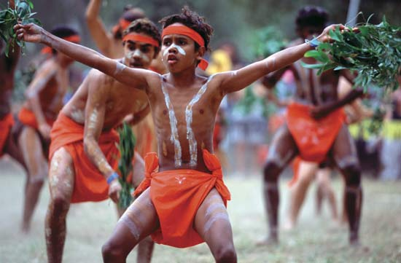
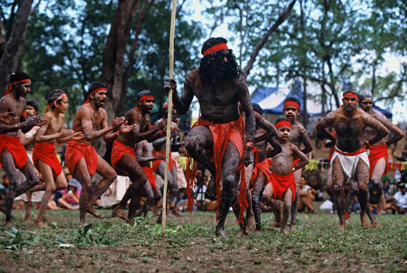
The Aborigines were indigenous, meaning they were the first people group to live in Australia.
The word Aborigine means “the people who were here from the beginning.”

Slide 6
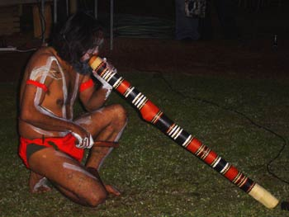
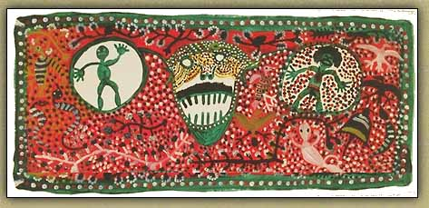
The Aborigines lived in harmony with each other and nature.
Their culture is expressed through art, music, language, dance and oral history.

Slide 7
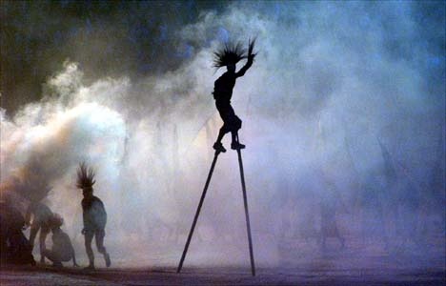
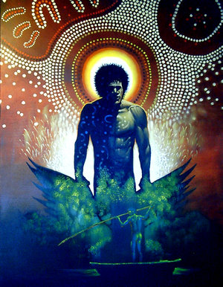
They tell of their beginnings and ancient history through stories of the DREAMTIME.

Slide 8
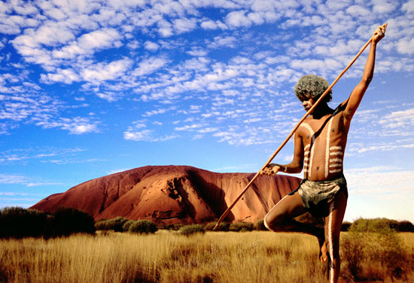
The Aborigines
Adapted and survived the harsh environment of the Outback
Built containers for storing water
Dug wells

Slide 9
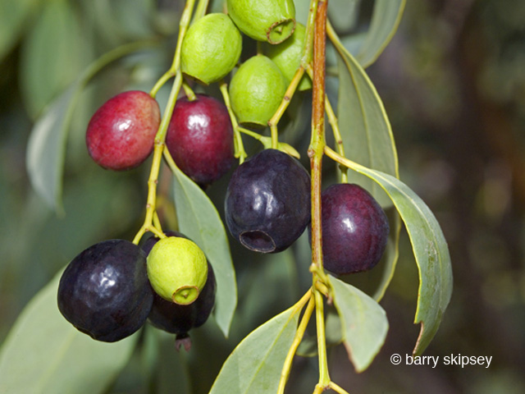
The Aborigines
Hunted and gathered food
Moved from place to place, making them nomads
The Bush Plum is a staple food for Aborigines living in the desert.

Slide 10
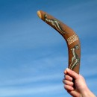
Archaeologists have found…
Aboriginal rock art
Inventions such as boomerangs, ground axes, and grindstones
No written record (History has been passed down by telling the stories from generation to generation.)

Slide 11
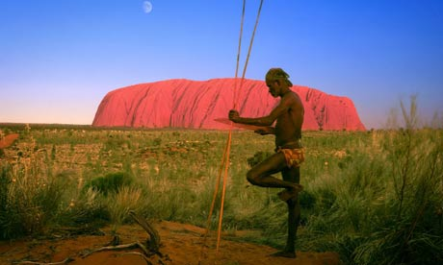
One of the sacred places of the Aborigines is Uluru, later named Ayer’s Rock by the British.

Slide 12
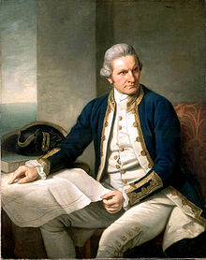
A big change was on the way for the Aborigines with the arrival of the first Europeans.
Explorer: Captain James Cook

Slide 13
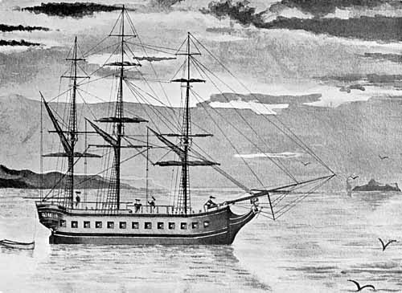
Colonization
Captain James Cook first claimed Australia for Great Britain.
The British officially started a colony in 1788.

Slide 14
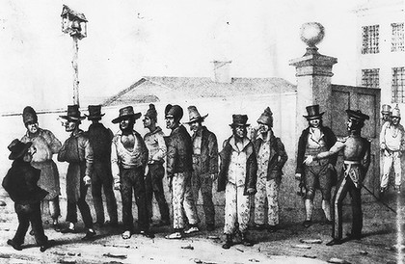
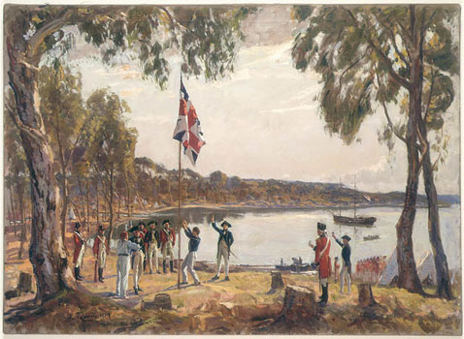
Among the first settlers were convicts from the prisons of Great Britain. After the American Revolution, Britain needed a place for all the extra prisoners.
British Government “Jail Gang”

Slide 15
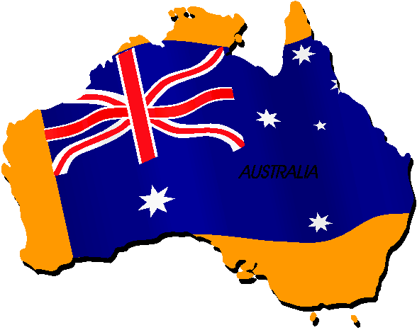
From 1788 to 1823 the colony of New South Wales in Australia was a penal (prison) colony.
Another reason the British wanted to settle Australia was to have a naval base in the Pacific.
There were also increased opportunities for trading.

Slide 16
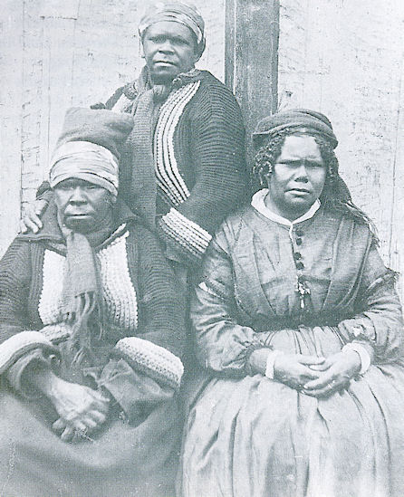
BIG CHANGES
The way of life for the Aborigines was interrupted when explorers and settlers began coming from Europe.
These Aboriginal women are dressed like Europeans.

Slide 17
As settlers built ranches, farms, and towns, they took over Aboriginal land.

Slide 18
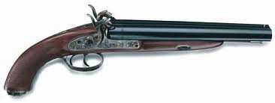
Sound familiar?
Sometimes the Aborigines would raid or attack an English settlement. The English would retaliate resulting in skirmishes.
The Aborigines were at a huge disadvantage because the English had modern weapons.
British
double-barrel pistol

Slide 19
Disease
Many Aborigines died of diseases brought unintentionally to Australia by the Europeans, especially smallpox.
The Aboriginal way of life began a struggle to survive.

Slide 20
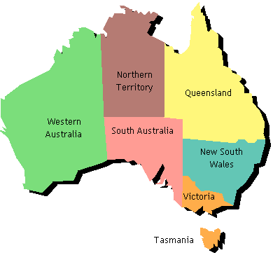
British Influence on the Language
The convicts, guards, and their families brought the English language to Australia.
What place names show British influence?

Slide 21
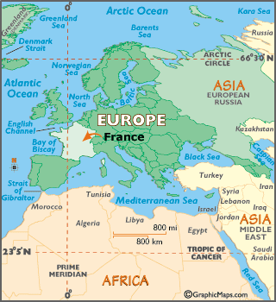
France was also interested in settling Australia. The British made settlements in the western part of Australia to keep the French out and spread the English influence.

Slide 22
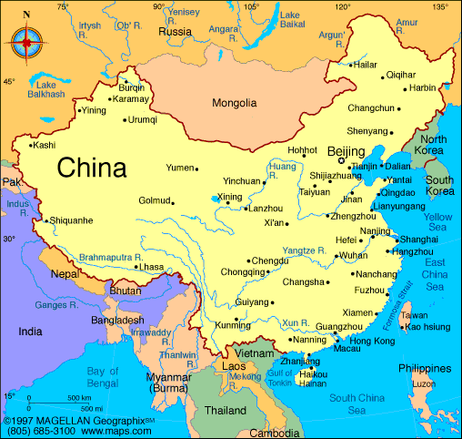
Chinese immigrants arrived in Australia as well, but Chinese did not become an important language because the English-speakers were too plentiful.

Slide 23
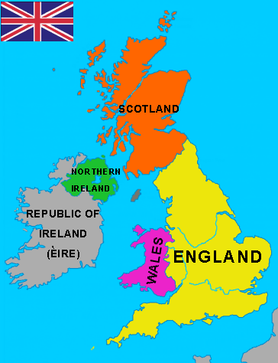
Because of Australia’s history, English is the official language today.
English is the most common language for business.

Slide 24
British Influence on the Religion
Europeans introduced Christianity to Australia in 1788.
Irish convicts were mostly Roman Catholic.
Many of the guards and their families were Protestants. They were from the Anglican Church (formerly known as Church of England) and Methodist Church.

Slide 25
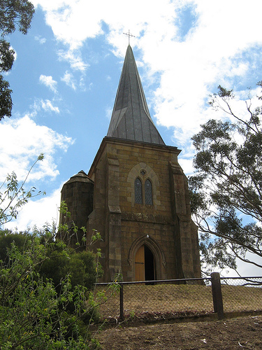
Today, most Australians are of the Christian faith.
The Roman Catholic Church and the Anglican Church claim the most members.
Muslims, Buddhists, Jews and Hindus combined make up less than 5% of the population.
Oldest Catholic Church in Australia built in1836

Slide 26
Aborigines Today
Now only represent 2.5% of the total population
Nearly 30 Aboriginal languages were wiped out by colonialism.
Many are in poor health and living in poverty, with a low level of education and employment compared to other Australians.

Slide 27
Recent Developments
In 2008, the Prime Minister officially apologized to the Aborigines and announced the government would begin to close the gaps between the Aboriginal people and other Australians.
Many say that the gaps are not being closed as the government promised. It is still controversial.

Slide 28
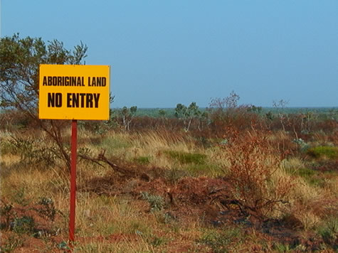
An example
of a
government
attempt to protect Aboriginal territory.
Sign says “ABORIGINAL LAND- NO ENTRY”.

Slide 29
Australia’s Government Today
SS6CG4 Explain forms of citizen participation in government.
a. Explain citizen participation in democratic governments (i.e. the role of citizens in choosing leaders of Australia- parliamentary democracy).

Slide 30
Australia Gains Independence
Great Britain controlled Australia from 1788 until 1901.
Australia gained independence from Britain, but still remains a part of the British Commonwealth of Nations.

Slide 31
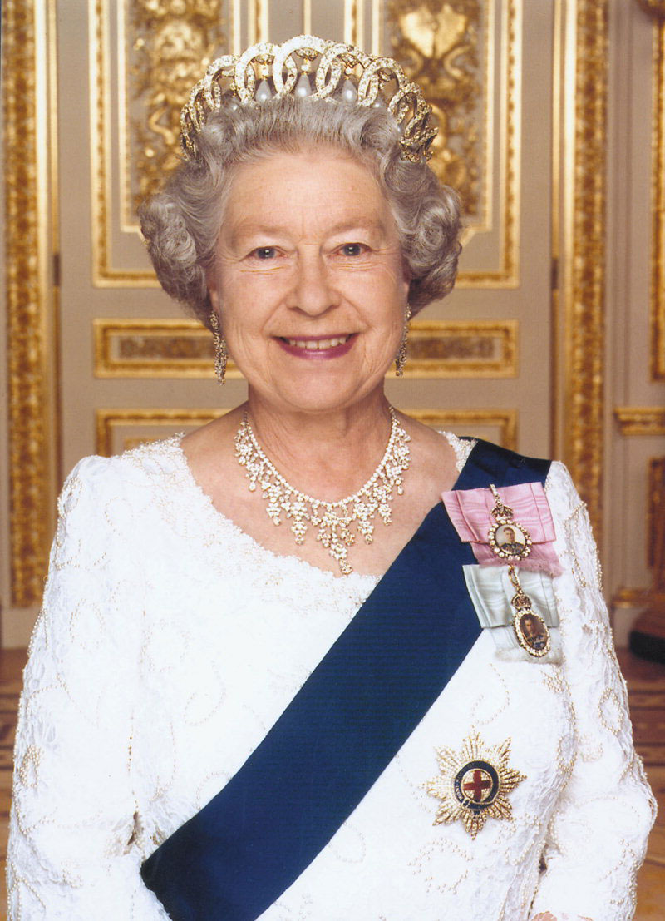
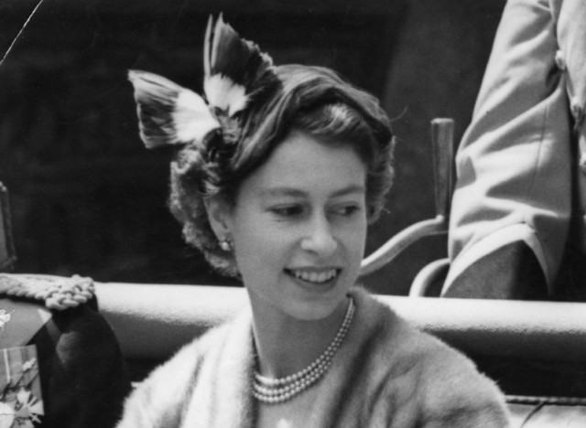
Even today, the British Monarch is also Australia's Monarch.
Queen Elizabeth II

Slide 32
Role of the Queen
Queen Elizabeth is the head of state for Australia. She lives in England, not Australia.
The Queen does not run the country.
She has duties such as signing laws and approving elections. These duties are carried out by an appointed governor-general.
She is considered the commander-in-chief.

Slide 33
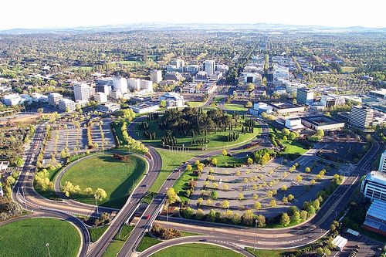
Parliamentary Democracy
Parliament is a legislative body or group of elected officials.
Democracy is government by the people.
Canberra

Slide 34
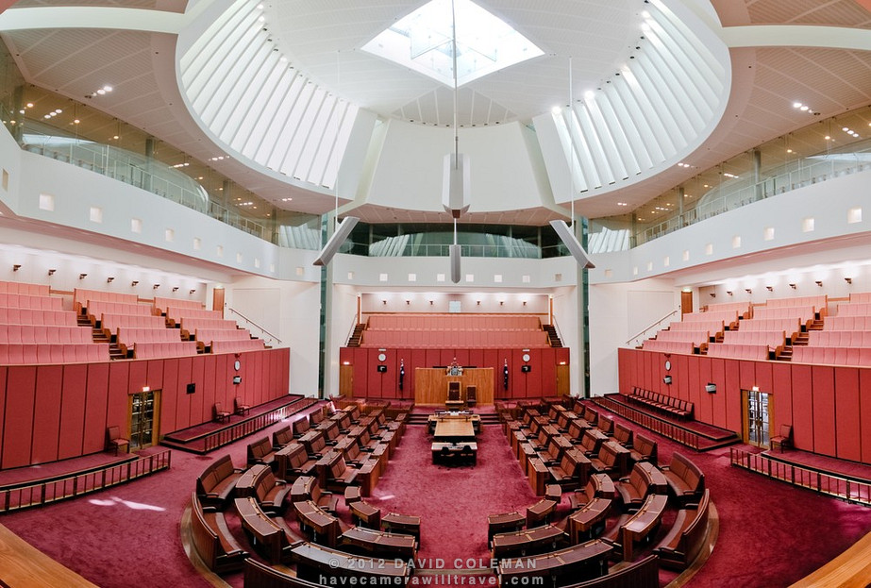
Parliament is divided into 2 houses:
House of Representatives
Senate
Senate Chamber

Slide 35
In Australia, the citizens vote for members of Parliament to represent them.
The leader of the political party that wins the most seats in the House of Representatives becomes the Prime Minister.

Slide 36
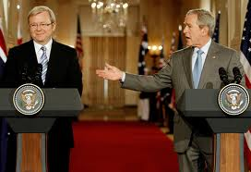
Role of the Prime Minister
The Prime Minister is the head of government
The person in this position is most powerful political figure in Australia.
Former Prime Minister Kevin Rudd with former President George Bush

Slide 37
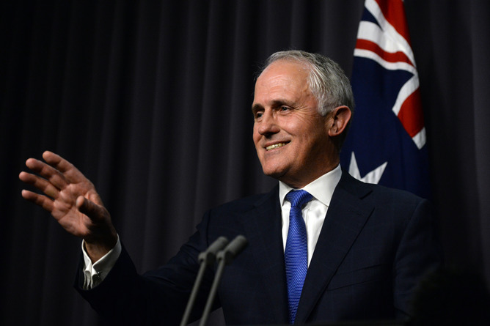
Prime Minister of Australia Today
Malcolm Turnbull was sworn in as the 29th Prime Minister of Australia on September 15th, 2015.

Slide 38
The Role of the Citizen
Australians have an important role in their government. Since they have a democratic form of the government, the voters choose the lawmakers.
All citizens over 18 years of age must vote. Voting is compulsory or required. If Australians do not vote they could be fined or they may have to go to court.

Slide 39
Australians vote for members of Parliament.
Voters do not vote for the head of state. The Queen holds that position.

Slide 40
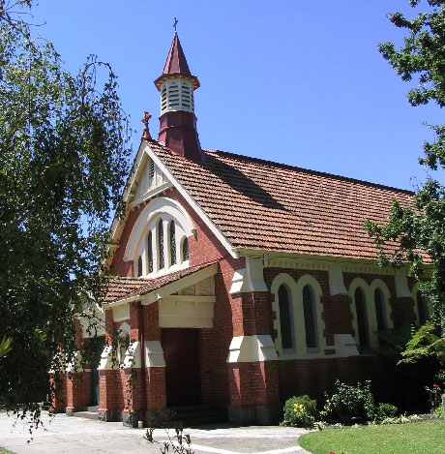
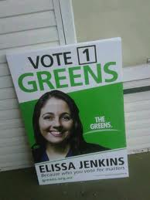
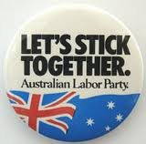
Personal Freedoms
Australians have:
Freedom of speech
Freedom of religion
Freedom to choose their own job
Freedom to travel
Opportunity to vote for leaders who make the laws

Slide 41
Australia’s Economy
SS6E10 Analyze different economic systems.
c. Describe the economic system of Australia.

Slide 42
Australian Economics
Australia has a mixed market economy, which means most economic decisions are made by the people.
The economic continuum:
Command Market
UK
Australia
Canada

Slide 43
Trade
Australia’s main trading partners are China and Japan.
At first, they became trading partners because China wanted Australia’s wool for its warmth and durability.
China and Japan buy Australia’s minerals for energy, construction, and technology.

Slide 44
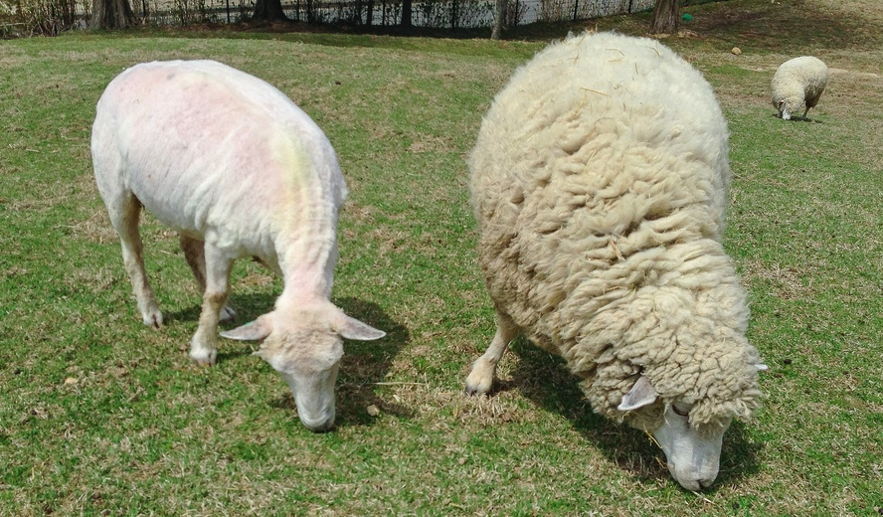
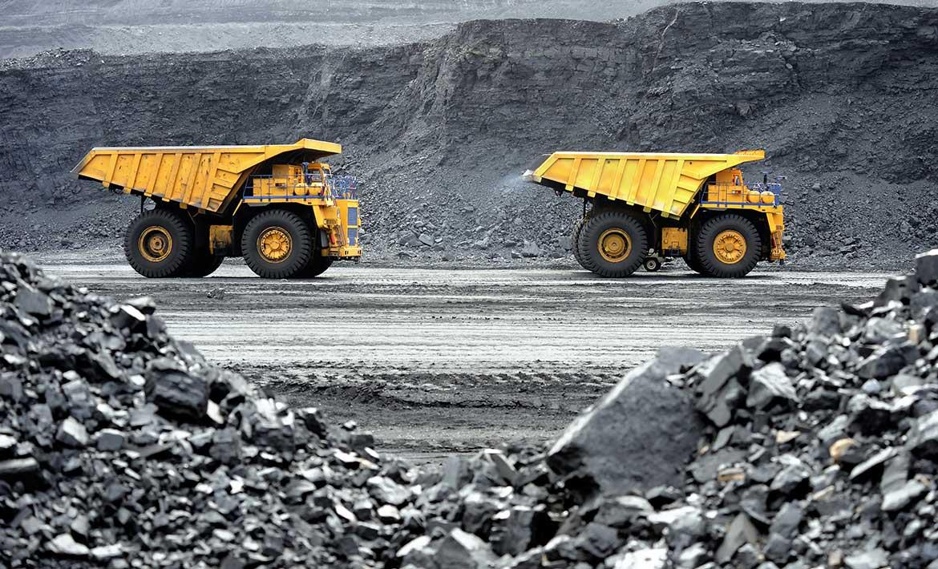
Australia specializes in exporting coal, iron ore, and wool. It has benefited from open market trade agreements with many of its trade partners.

Slide 45
Trade Barriers
Tariff- a tax on imported goods
Quota- a limit on the amount of products that can be imported into a country.
Embargos- prohibit trade with another country
Australia does have embargoes against Myanmar and North Korea over those nations’ human rights abuses.

Slide 46
Currency
Australia uses the Australian dollar. In order to trade with other nations, a currency exchange must exist.
An exchange rate is used to determine how much one nation’s currency is worth in terms of another’s.
Example: 1.00 U.S. dollar = 1.39 Australian dollars

Slide 47
Factors that Influence Economic Growth
Australia currently has a:
literacy rate of 99%
life expectancy of 82.45 years
GDP per capita of $47,600
What would you say about its standard of living??

Slide 48
The standard of living is high.

