Slide 1
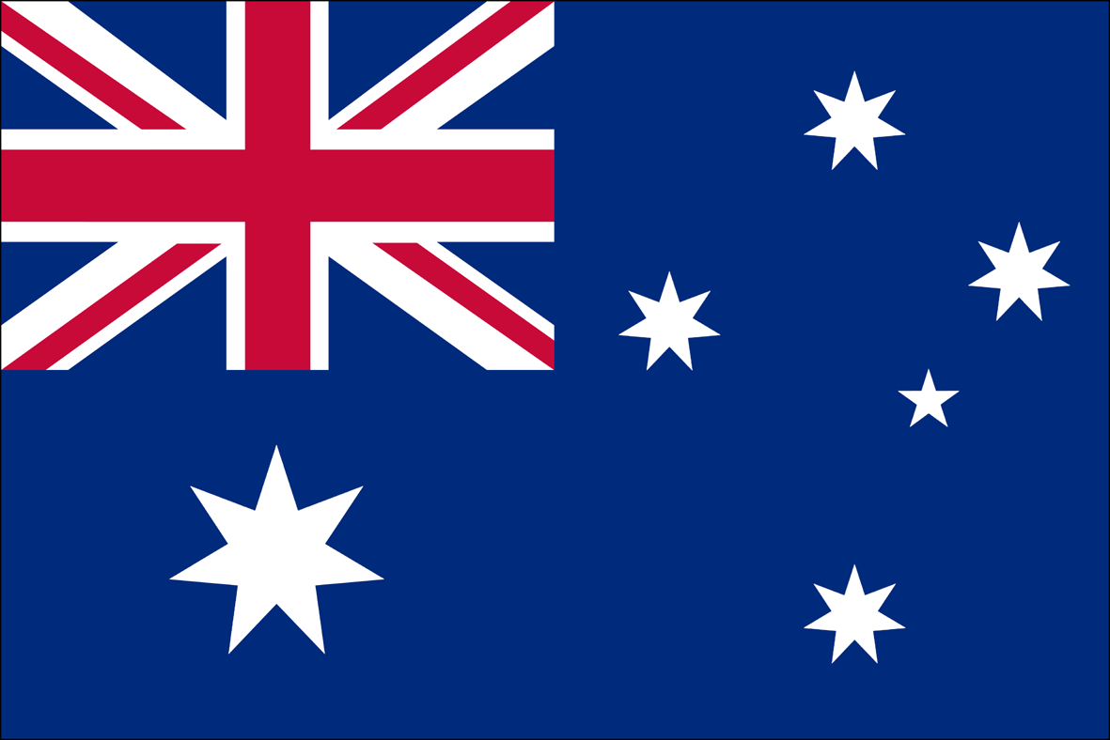
Australia Geography

Slide 2
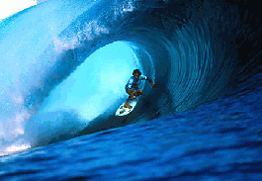
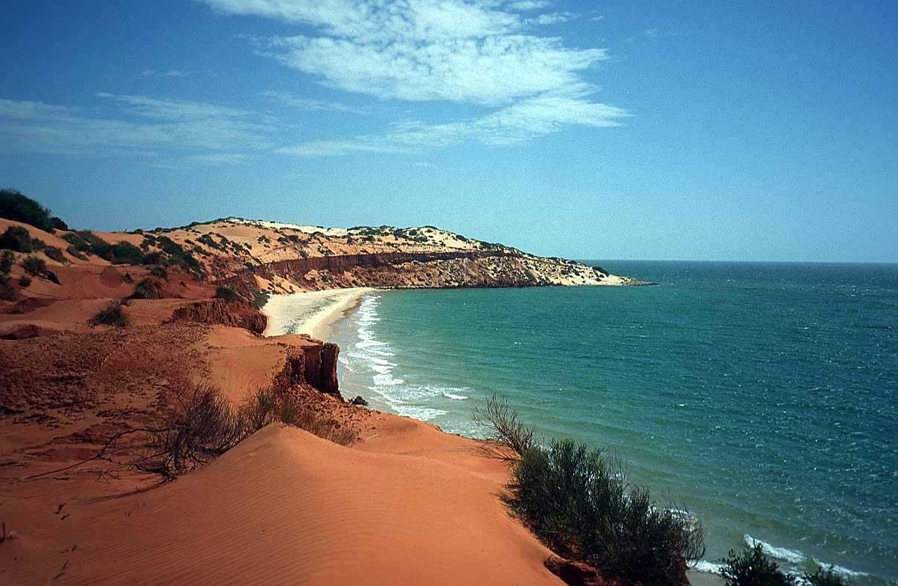
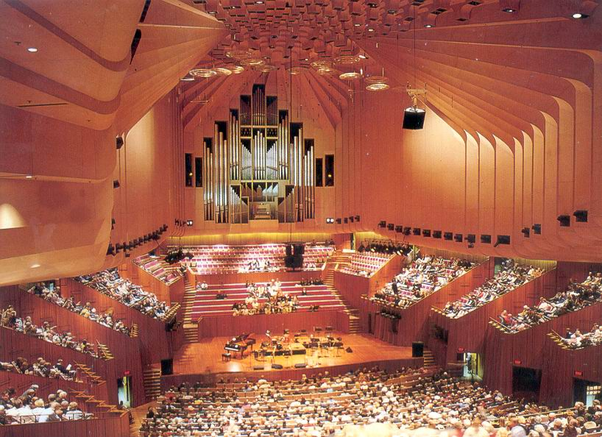
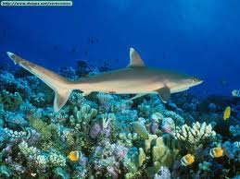
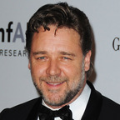
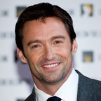
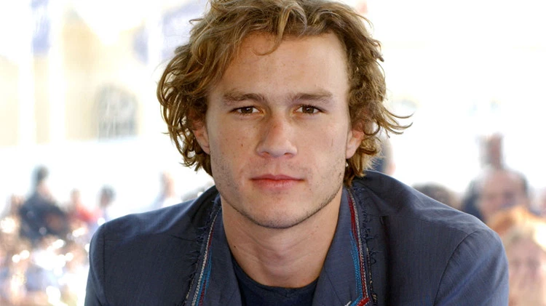
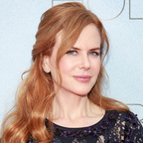
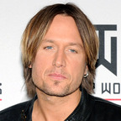
Australia
Russell Crowe
Hugh Jackman
Heath Ledger
Nicole Kidman
Keith Urban

Slide 3
Standard:
The student will be able to locate selected features of Australia: the Great Barrier Reef, Coral Sea, Ayers Rock, Indian Ocean, Pacific Ocean, Great Dividing Range, and Great Victoria Desert.

Slide 5
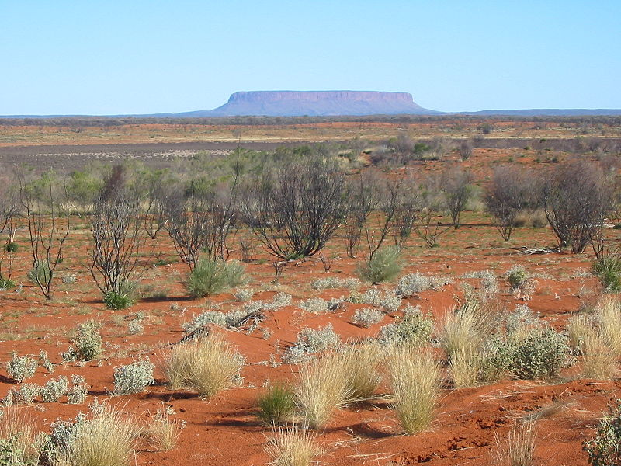
“Unique” Australia
It is the smallest continent and the oldest.
The soil is the oldest on earth and least fertile.
44% of Australia is desert

Slide 6
Where is Australia?

Slide 7
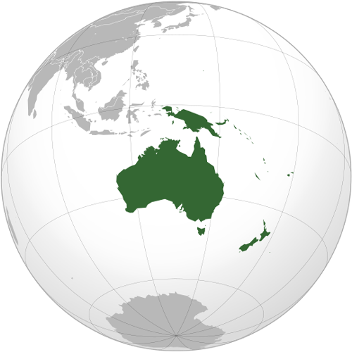
“Unique” Australia
Australia is a country, a continent and an island
Two major oceans surround Australia and many seas.
The only continent that receives LESS rainfall than Australia is Antarctica.
Antarctica

Slide 8
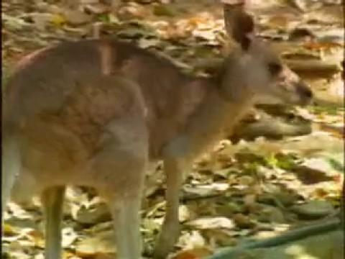

Slide 9
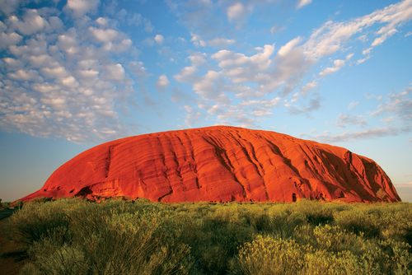
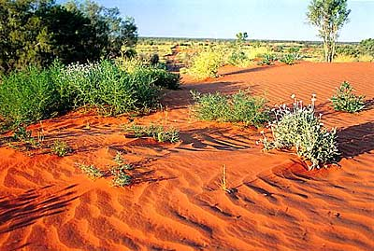
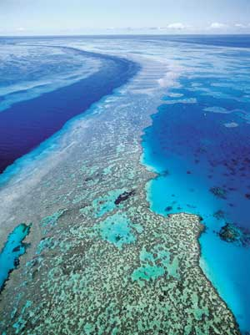
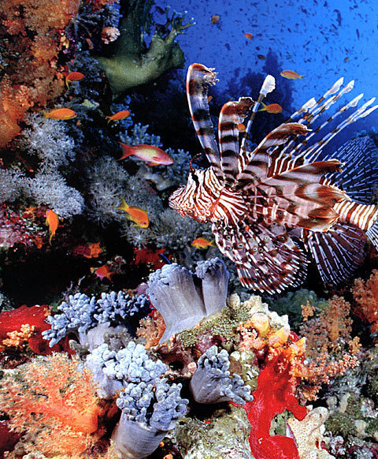
Major Physical Features
Great Barrier Reef
Coral Sea
Ayers Rock (Uluru)
Great Victoria Desert
Great Dividing Range
Indian Ocean
Pacific Ocean

Slide 10
Where are they?
Coral Sea
Indian Ocean
Great Barrier Reef
Ayers Rock
Great Dividing Range
Great Victoria Desert
Pacific Ocean

Slide 11
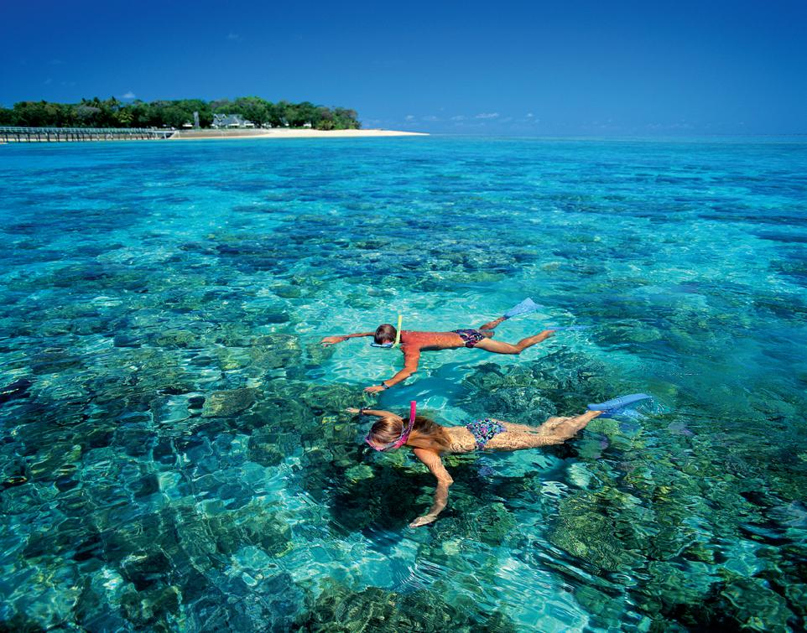
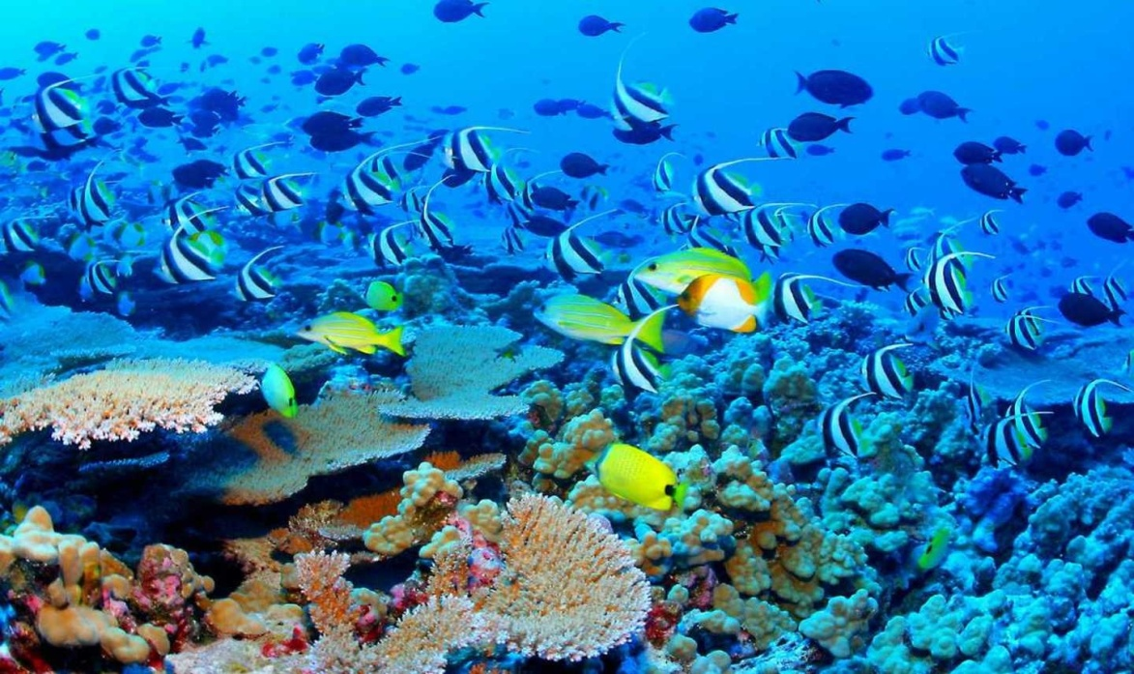
Great Barrier Reef
World’s largest coral reef
Located off NE coast of Australia
More than 1,200 miles long
Part of Coral Sea
400 types of coral
More than 1,500 species of fish
4,000 types of mollusks (animals like snails, clams, octopi, & squid)

Slide 12
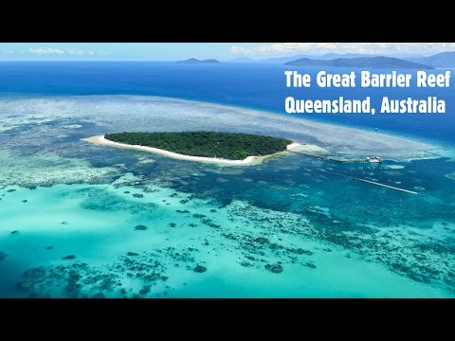
GBR Video

Slide 13
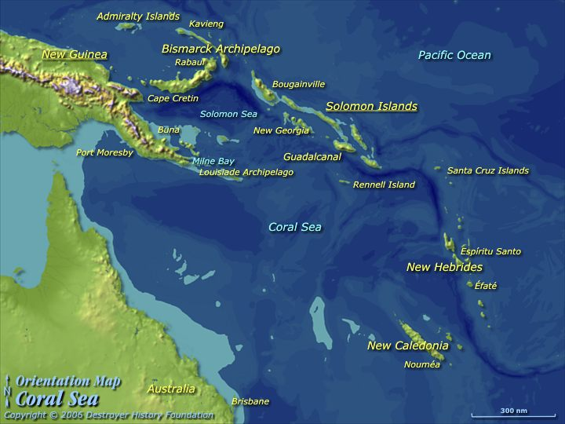
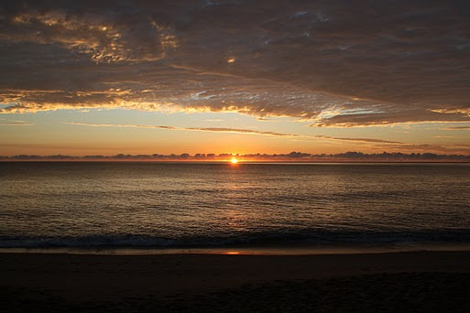
Coral Sea
It is part of the Pacific Ocean
Located off NE coast of Australia
G.B.R. is located here

Slide 14
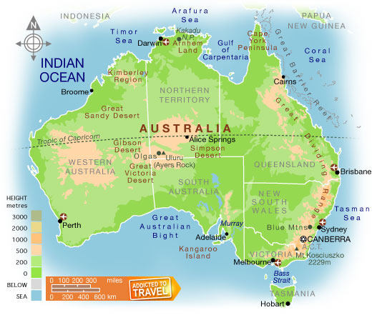
Ayers Rock (Uluru)
It is the visible tip of a massive underground sandstone rock cemented together by sand & mud.
It is gray, but it has rusted, giving it the reddish color because of its iron content.
Located 208 miles SW of the nearest town of any size; Alice Springs.
Almost 6 miles wide at its base and 1,142 ft. high (from top to bottom)
Stone Mountain is 825 ft tall from top to bottom.

Slide 15
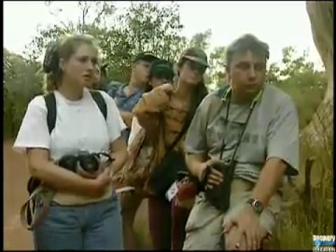

Slide 16
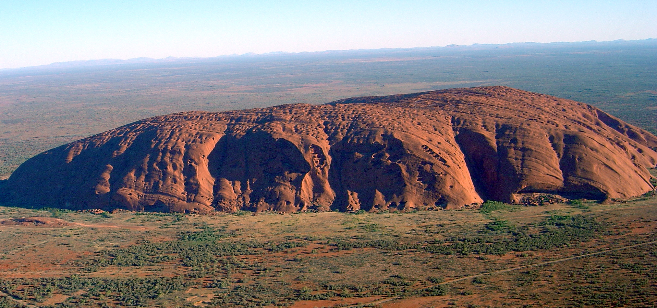

Slide 17
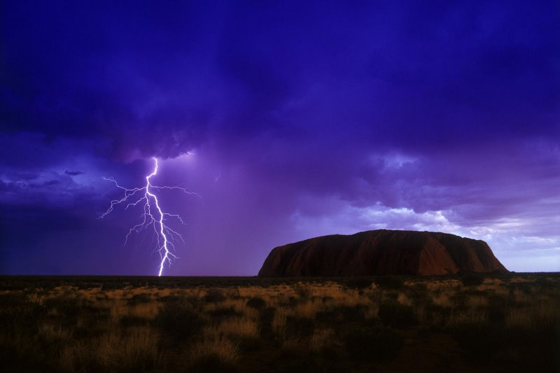

Slide 18
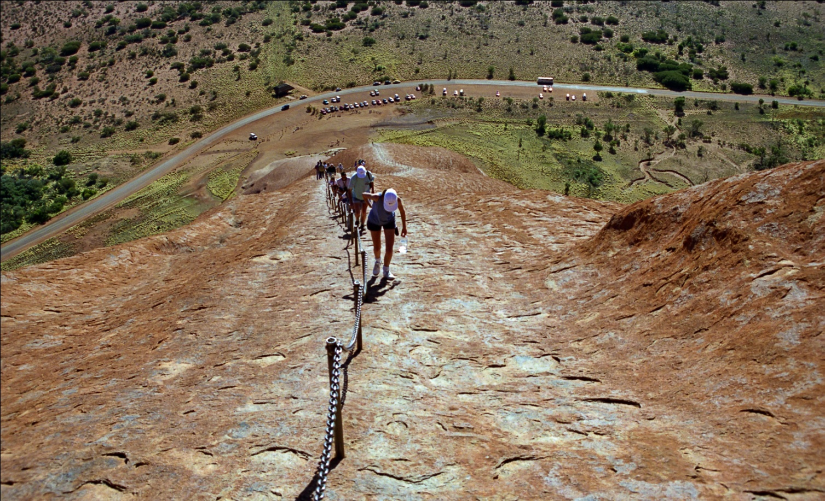
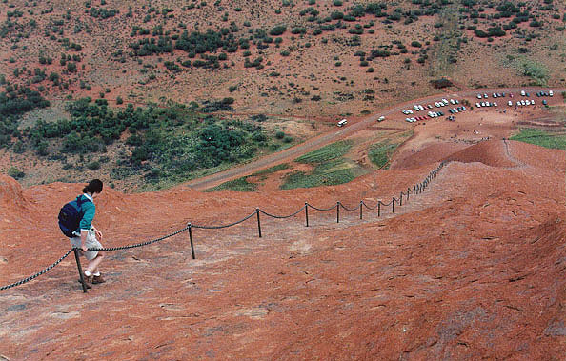

Slide 19
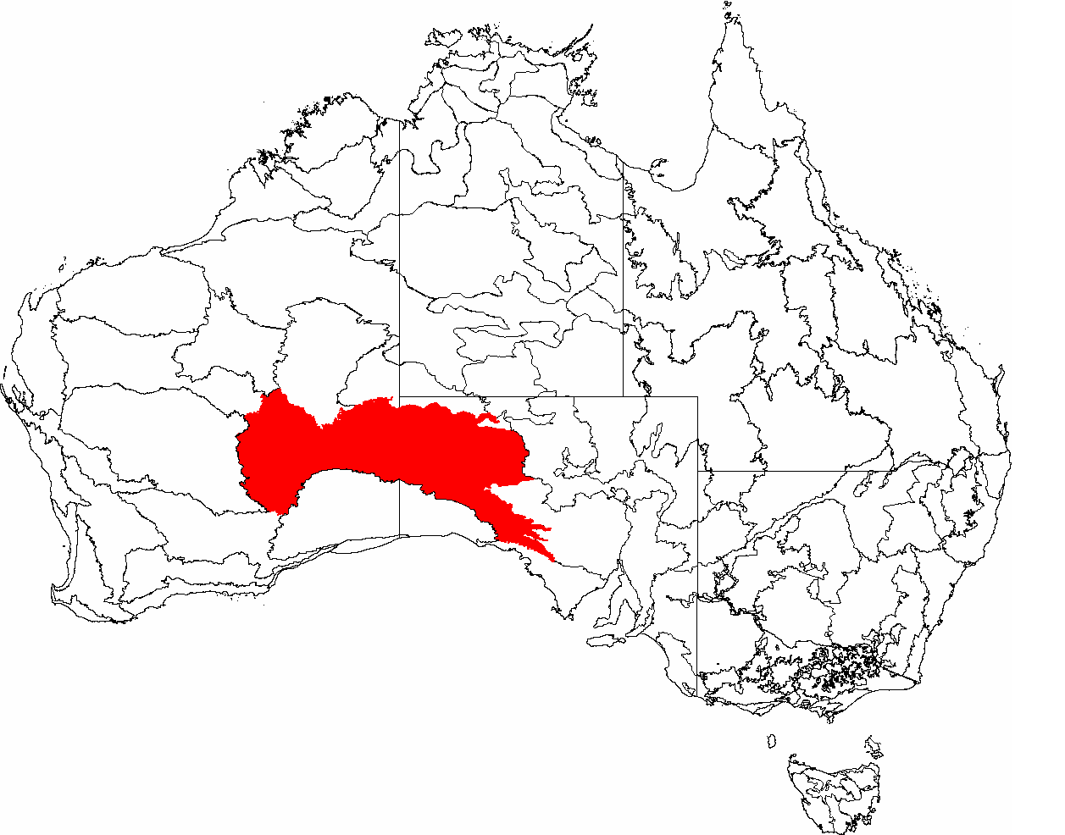
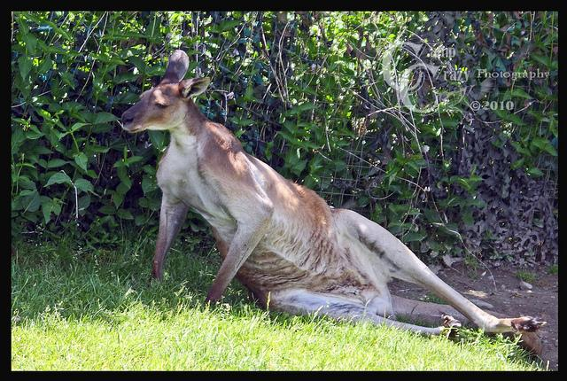
Great Victoria Desert
Only receives 8 to 10 inches of rain/year
It never snows
Named after British Queen Victoria
1st Europeans crossed it in 1875
160,000 square miles!
Very few people live there because it is too hot and dry
(arid)
Man, its HOT!

Slide 20
Great Dividing Range
Australia’s longest
mountain range at
2,300 miles long
Divides Australia’s eastern coastal region from the inland desert region
Contains lush
rainforests and snow-
capped mountains

Slide 21
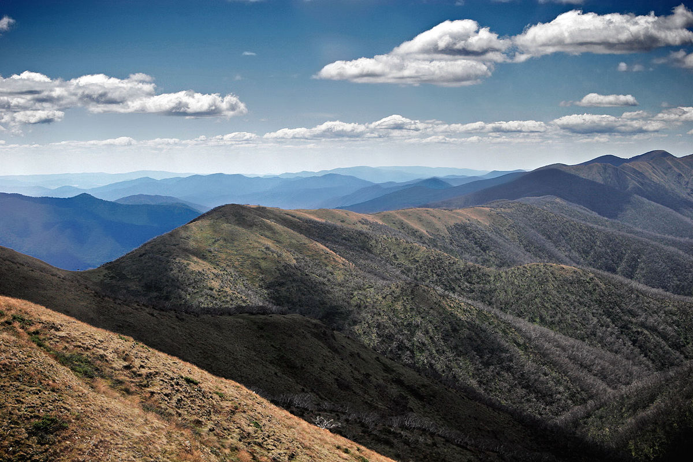

Slide 22
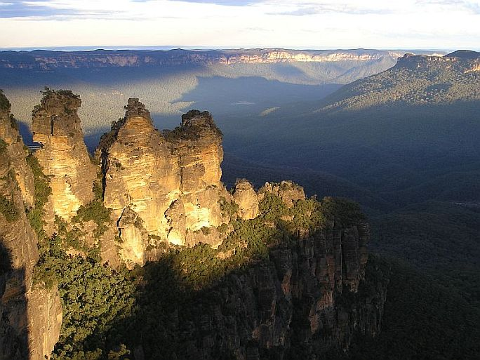

Slide 23
Indian Ocean
World’s 3rd largest ocean.
Roughly 5.5 times the size of the USA.
It’s the warmest ocean in the world, and because of this it does not support sea life very well.
A major port for the Indian Ocean is in Melbourne, Australia.
40% of the world’s oil comes from the Indian Ocean.

Slide 24
Pacific Ocean
The equator divides the Pacific Ocean into North and South.
It is the biggest and deepest ocean in the world.
Covers more than 33% of the world’s surface and 46% of earth’s water surface!
Most of the world’s volcanoes are in the pacific ocean in the Ring of Fire.

Slide 25
Standard:
The student will be able to describe how Australia’s location, climate, and natural resources affect where people live.

Slide 26
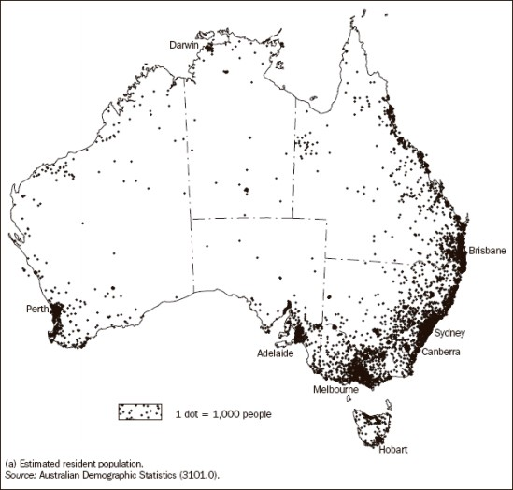
Australia’s Location
The country lies in the Southern Hemisphere.
Aussie’s say they come from the “land down under” because their country is on the lower part of the globe.
Coastal areas are the most populated.
80% of Australians live in urban areas.
Since it is below the equator, the seasons are reversed from our seasons.

Slide 27
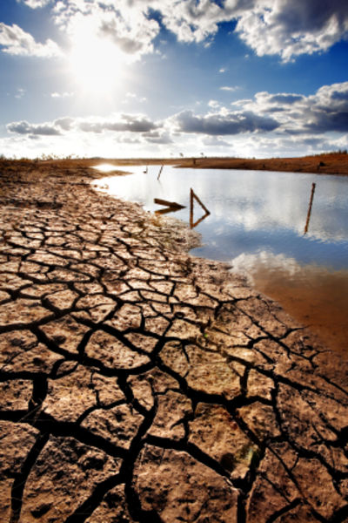
Australia’s Climate
Dec-March= Summer
June-September=Winter
Southeast & Southwest areas have a temperate climate.
The Outback has an arid climate.
Northern part of Australia is near the equator so it has a tropical climate & is warm to hot year round.
This area also gets more rain than other parts of the country.

Slide 28
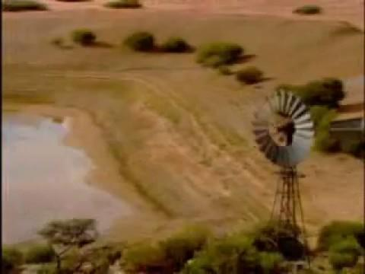

Slide 29
Merry Christmas, mate!

Slide 30
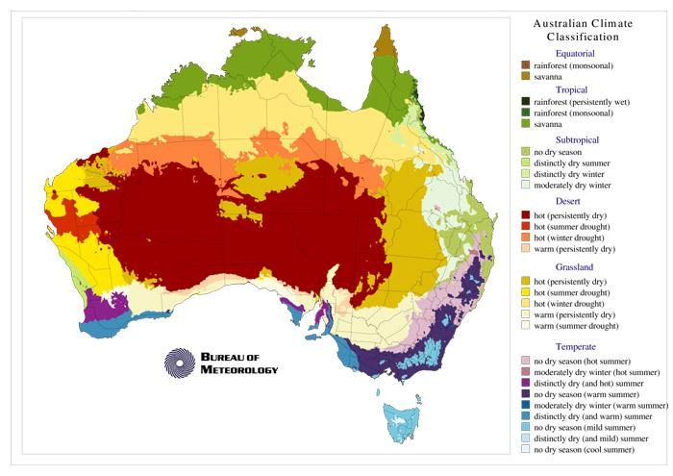

Slide 31
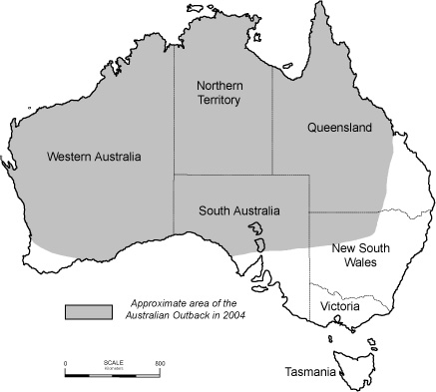
The Remote Part of Australia
Australians call remote wilderness the “bush”
“Outback” is the country’s dry interior
The Outback is mainly open, flat, dry land with very few inhabitants.

Slide 32
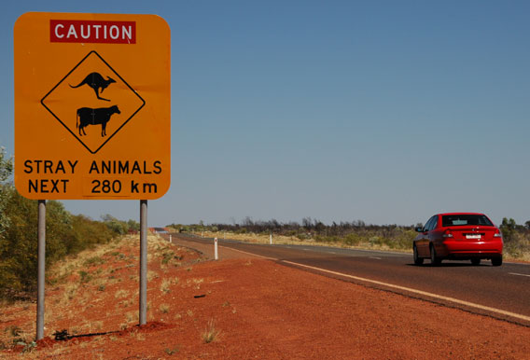
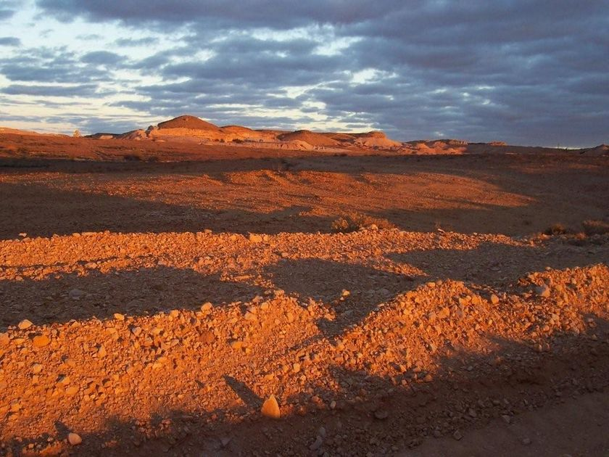
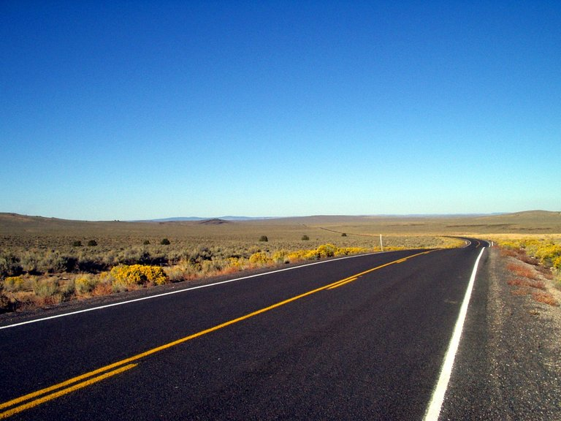
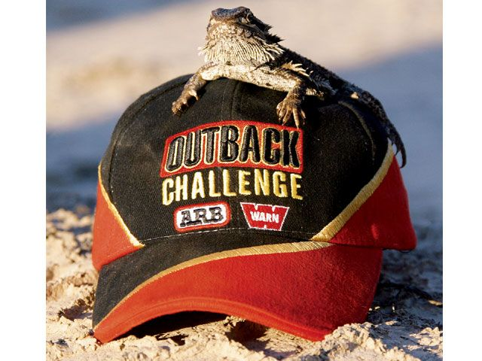
The Outback

Slide 33
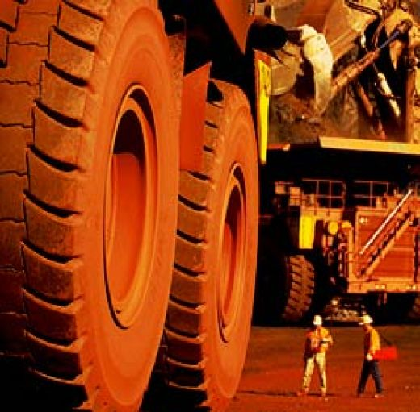
Natural Resources of Australia
Australians mine for coal, iron ore, copper, gold, silver, diamonds, etc.
Australia’s minerals are often found in areas that are difficult to reach.

Slide 34
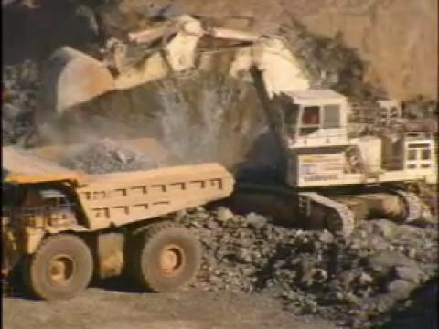

Slide 35
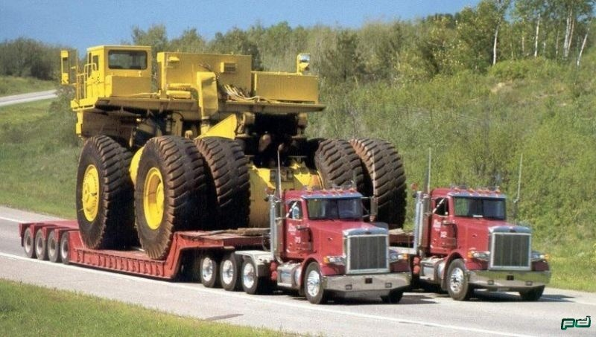

Slide 36
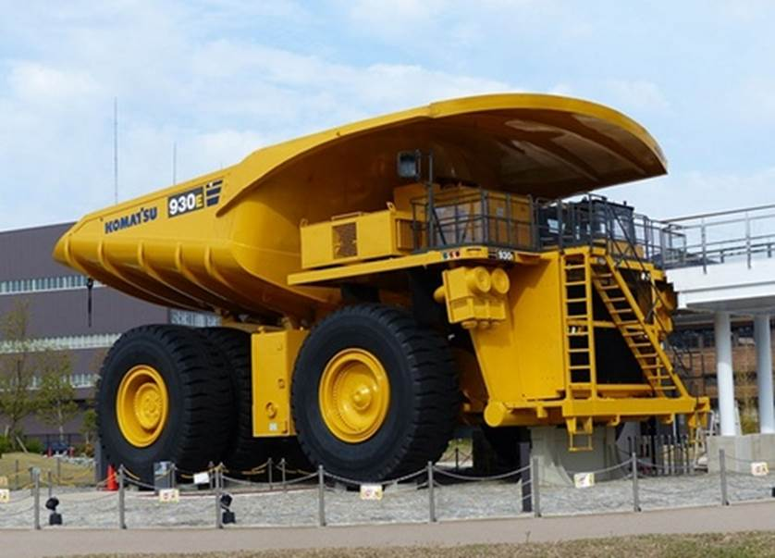

Slide 37
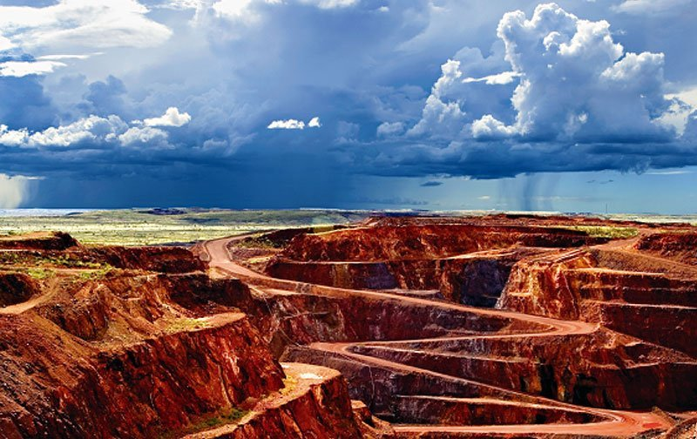
Natural Resources of Australia
Highways and railroads are expensive to build, but they are needed to get workers and machinery to remote locations.
Once the minerals are mined, expensive equipment is needed to move the minerals to populated areas for trade.
REMOTE, REMOTE, REMOTE!!!

Slide 38
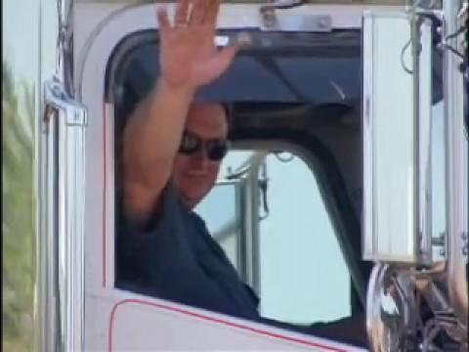

Slide 39
Where people live
80% of Australians live in Urban Areas.
Most people live on the Southeast & Southwest coasts.
Remote places where no people live is called “the Bush”

Slide 40
